Slide 1
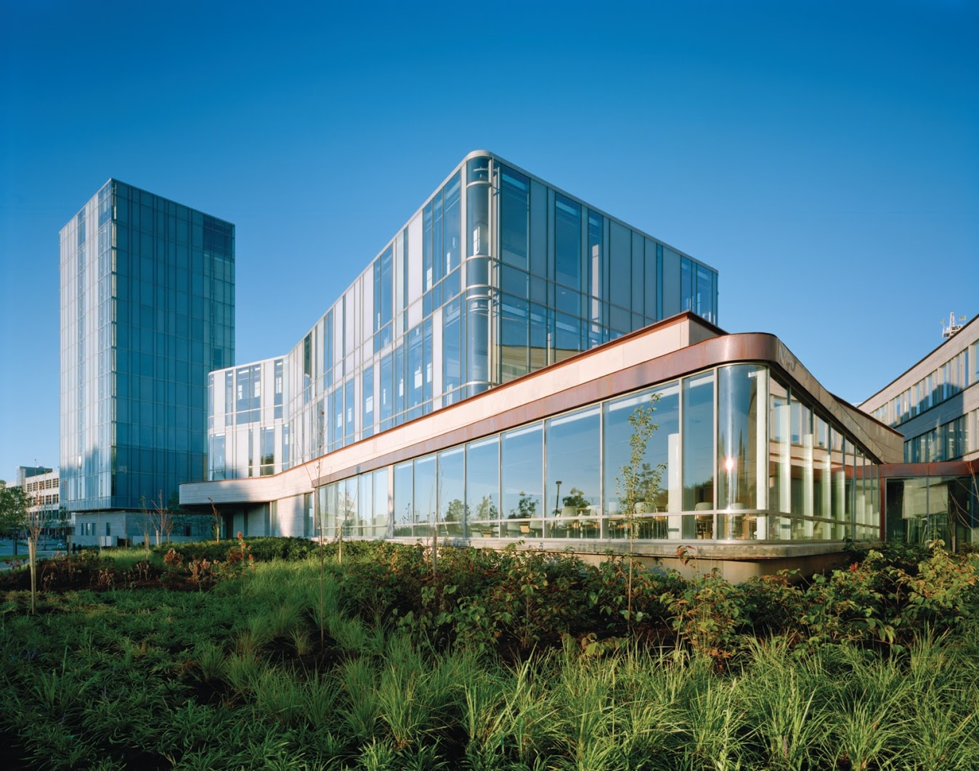
`
Schulich School of Business MBAN 6120
MODULE 3 : Characteristics of Time Series
Data Science II
Instructor: Boris Garbuzov
MBAN 6120
Fall 2020
SCHULICH SCHOOL OF BUSINESS | MBAN 6120
MODULE 1
Data Science II
2020

Slide 2
Agenda
Administrative
Characteristics of Time Series . . . . . . . . . . . . . . . . . . . . . . . . . . . . . . . . . . . 1
1.1 The Nature of Time Series Data . . . . . . . . . . . . . . . . . . . . . . . . . . . . . . 2
Insertion. Basic manipulations of time series
1.2 Time Series Statistical Models . . . . . . . . . . . . . . . . . . . . . . . . . . . . . . . . 8
1.3 Measures of Dependence . . . . . . . . . . . . . . . . . . . . . . . . . . . . . . . . . . . . 14
1.4 Stationary Time Series . . . . . . . . . . . . . . . . . . . . . . . . . . . . . . . . . . . . . . 19
1.5 Estimation of Correlation . . . . . . . . . . . . . . . . . . . . . . . . . . . . . . . . . . . . 26
Questions. (Last 10 minutes)

Slide 3
Chapter 1 Characteristics of Time Series
1.1 The Nature of Time Series Data

Slide 4
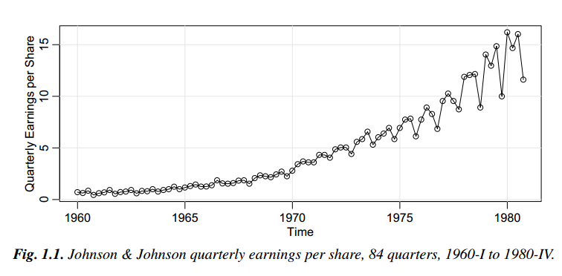
Example 1.1 Johnson & Johnson Quarterly Earnings
Modeling such series begins by observing the primary patterns in the time history. In this case, note the gradually increasing underlying trend and the rather regular variation superimposed on the trend that seems to repeat over quarters.

Slide 5
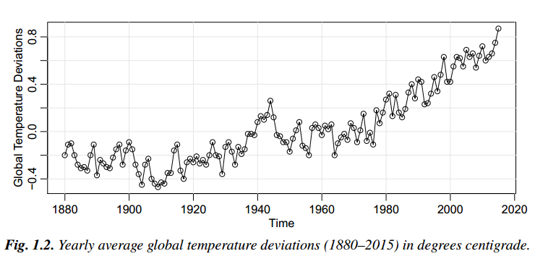
Example 1.2 Global Warming
We note an apparent upward trend in the series during the latter part of the twentieth century that has been used as an argument for the global warming hypothesis. Note also the leveling off at about 1935 and then another rather sharp upward trend at about 1970. The question of interest for global warming proponents and opponents is whether the overall trend is natural or whether it is caused by some human-induced interface.

Slide 6
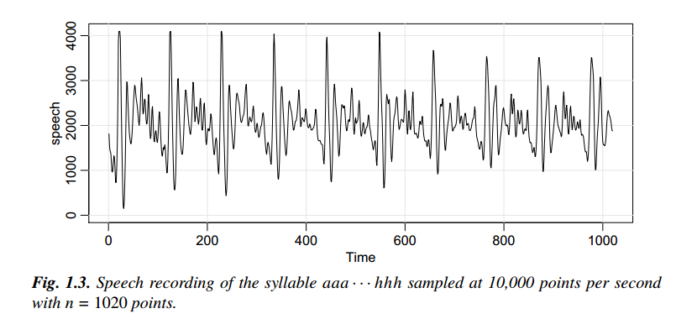
Example 1.3 Speech Data
One current problem of great interest is computer recognition of speech, which would require converting this particular signal into the recorded phrase. Spectral analysis can be used in this context to produce a signature of this phrase that can be compared with signatures of various library syllables to look for a match

Slide 7
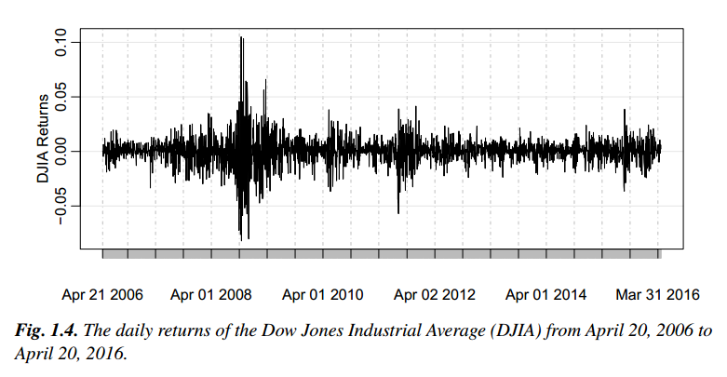
Example 1.4 Dow Jones Industrial Average
The mean of the series appears to be stable with an average return of approximately zero, however, highly volatile (variable) periods tend to be clustered together. A problem in the analysis of these type of financial data is to forecast the volatility of future returns. Models such as ARCH and GARCH models and stochastic volatility models have been developed to handle these problems.

Slide 8
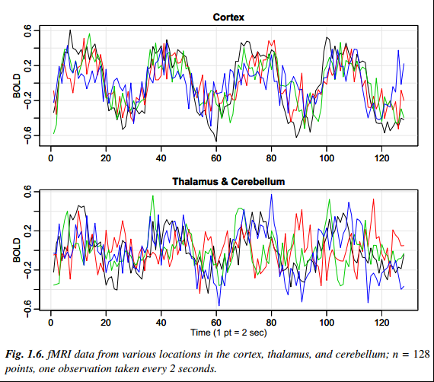
Example 1.5 El Niño and Fish Population
We may also be interested in analyzing several time series at once.
Both series in Figure 1.6 exhibit repetitive behavior, with regularly repeating cycles that are easily visible. This periodic behavior is of interest because underlying processes of interest may be regular and the rate or frequency of oscillation characterizing the behavior of the underlying series would help to identify them.

Slide 9
Chapter 1 Characteristics of Time Series
1.2 Time Series Statistical Models

Slide 10
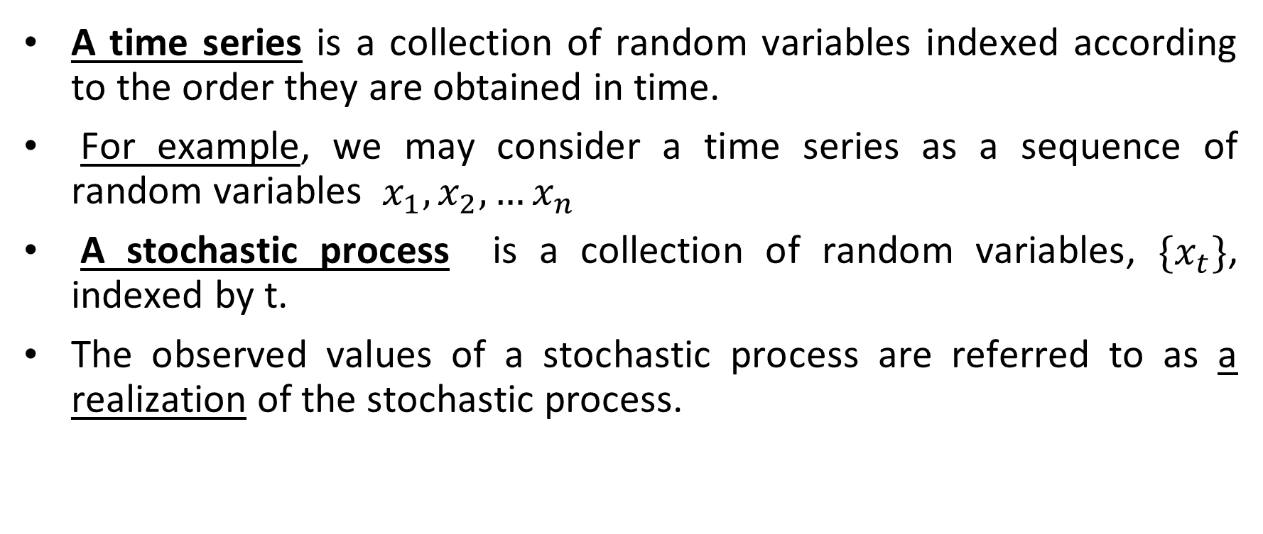
Definition of Time series
A time series is a collection of random variables indexed according to the order they are obtained in time.
For example, we may consider a time series as a sequence of random variables $x_{1},x_{2},…x_{n}$
A stochastic process is a collection of random variables, $\{x_{t}\}$, indexed by t.
The observed values of a stochastic process are referred to as a realization of the stochastic process.

Slide 11
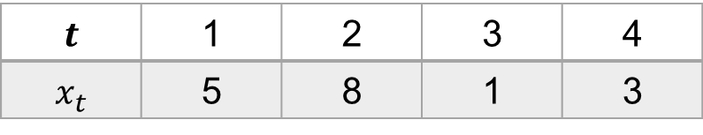
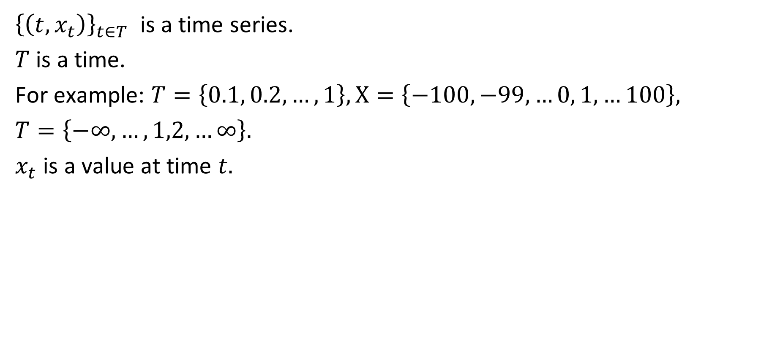
Basic manipulations with series
${\left\{\left(t,x_{t}\right)\right\}}_{t∈T}$ is a time series.
$T$ is a time.
For example: $T=\left\{0.1, 0.2,…, 1\right\}, X=\left\{−100, −99, …0, 1,…100\right\},$
$T=\left\{−∞, …,1,2,…∞\right\}.$
$x_{t}$ is a value at time $t.$
$$t$$ | 1 | 2 | 3 | 4
$$x_{t}$$ | 5 | 8 | 1 | 3

Slide 12
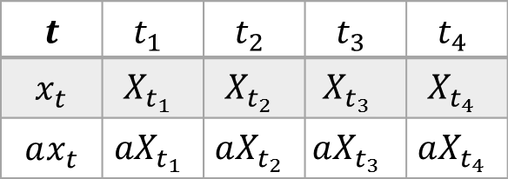
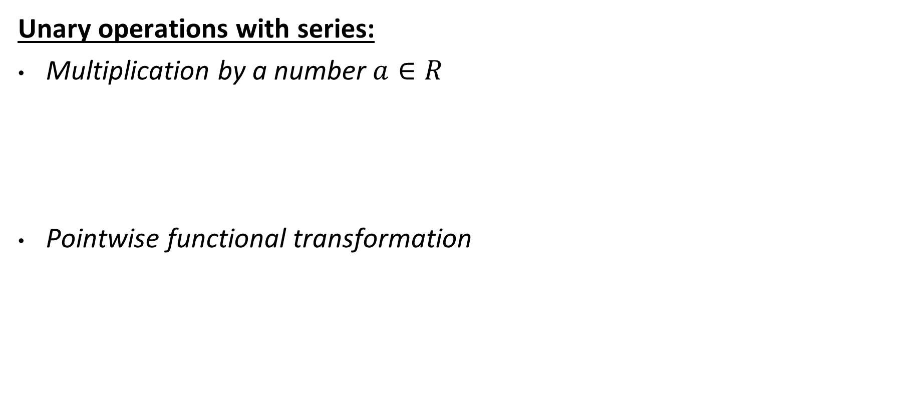
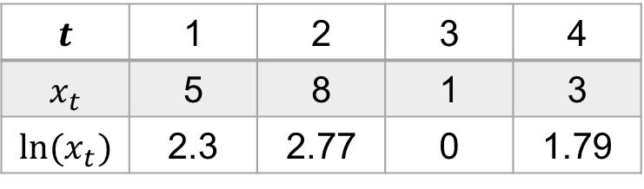
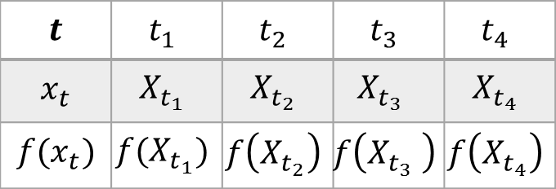
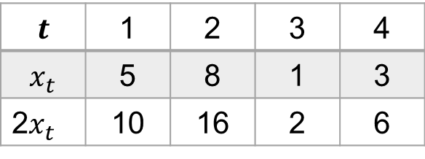
Basic manipulations with series
Unary operations with series:
Multiplication by a number $a∈R$
Pointwise functional transformation
$$t$$ | $$t_{1}$$ | $$t_{2}$$ | $$t_{3}$$ | $$t_{4}$$
$$x_{t}$$ | $$X_{t_{1}}$$ | $$X_{t_{2}}$$ | $$X_{t_{3}}$$ | $$X_{t_{4}}$$
$$ax_{t}$$ | $${aX}_{t_{1}}$$ | $$aX_{t_{2}}$$ | $$aX_{t_{3}}$$ | $$aX_{t_{4}}$$
$$t$$ | 1 | 2 | 3 | 4
$$x_{t}$$ | 5 | 8 | 1 | 3
2$x_{t}$ | 10 | 16 | 2 | 6
$$t$$ | $$t_{1}$$ | $$t_{2}$$ | $$t_{3}$$ | $$t_{4}$$
$$x_{t}$$ | $$X_{t_{1}}$$ | $$X_{t_{2}}$$ | $$X_{t_{3}}$$ | $$X_{t_{4}}$$
$$f(x_{t})$$ | $${f(X}_{t_{1}})$$ | $$f\left(X_{t_{2}}\right)$$ | $$f\left(X_{t_{3}} \right)$$ | $$f\left(X_{t_{4}}\right)$$
$$t$$ | 1 | 2 | 3 | 4
$$x_{t}$$ | 5 | 8 | 1 | 3
$$ln⁡(x_{t})$$ | 2.3 | 2.77 | 0 | 1.79

Slide 13
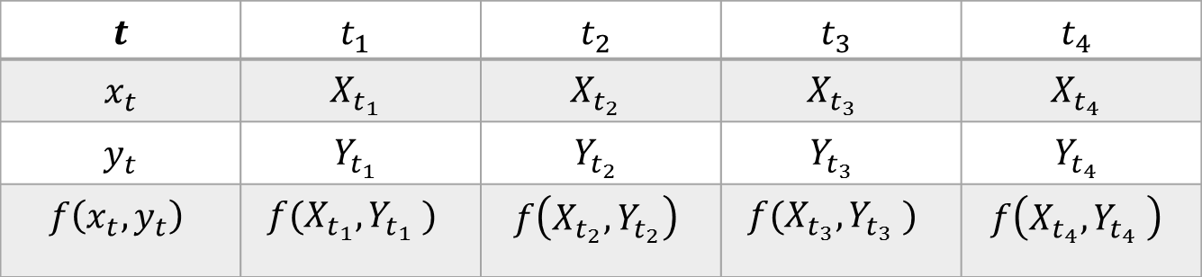
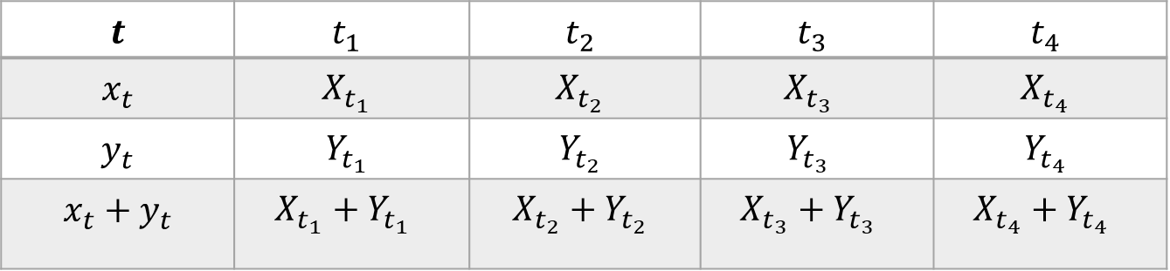
Basic manipulations with series
Binary operations with two series:
Addition
Pointwise functional transform f of a pair
$$t$$ | $$t_{1}$$ | $$t_{2}$$ | $$t_{3}$$ | $$t_{4}$$
$$x_{t}$$ | $$X_{t_{1}}$$ | $$X_{t_{2}}$$ | $$X_{t_{3}}$$ | $$X_{t_{4}}$$
$$y_{t}$$ | $$Y_{t_{1}}$$ | $$Y_{t_{2}}$$ | $$Y_{t_{3}}$$ | $$Y_{t_{4}}$$
$$x_{t}+y_{t}$$ | $$X_{t_{1}}+Y_{t_{1}}$$ | $$X_{t_{2}}+Y_{t_{2}}$$ | $$X_{t_{3}}+Y_{t_{3}}$$ | $$X_{t_{4}}+Y_{t_{4}}$$
$$t$$ | $$t_{1}$$ | $$t_{2}$$ | $$t_{3}$$ | $$t_{4}$$
$$x_{t}$$ | $$X_{t_{1}}$$ | $$X_{t_{2}}$$ | $$X_{t_{3}}$$ | $$X_{t_{4}}$$
$$y_{t}$$ | $$Y_{t_{1}}$$ | $$Y_{t_{2}}$$ | $$Y_{t_{3}}$$ | $$Y_{t_{4}}$$
$$f\left(x_{t},y_{t}\right)$$ | $${f(X}_{t_{1}},Y_{t_{1}} )$$ | $$f\left(X_{t_{2}},Y_{t_{2}}\right)$$ | $${f(X}_{t_{3}},Y_{t_{3}} )$$ | $$f\left(X_{t_{4}},Y_{t_{4}} \right)$$

Slide 14
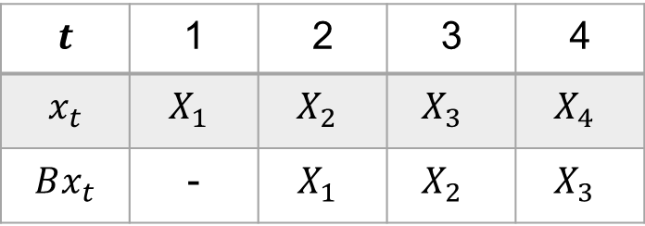
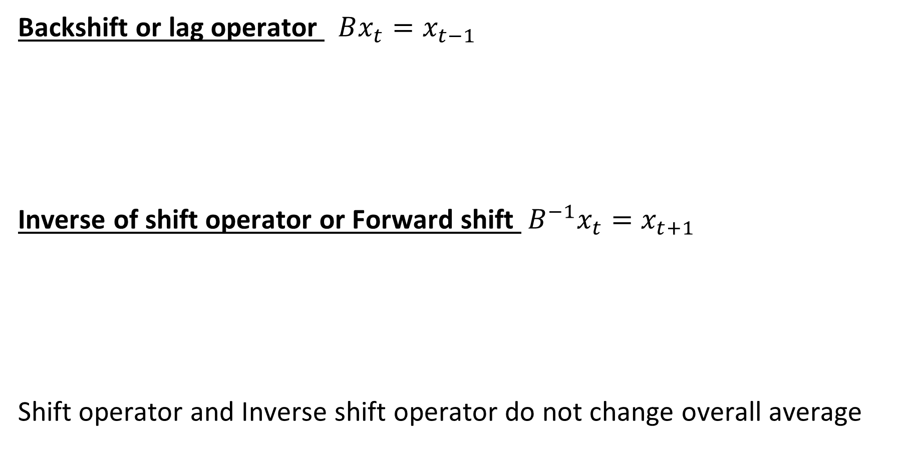
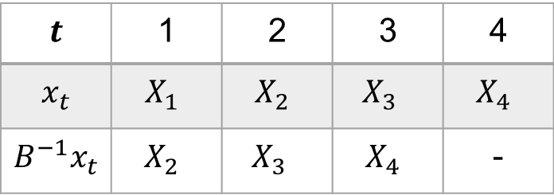
Basic manipulations with series
Backshift or lag operator $Bx_{t}=x_{t−1}$
Inverse of shift operator or Forward shift $B^{−1}x_{t}=x_{t+1}$
Shift operator and Inverse shift operator do not change overall average
$$t$$ | 1 | 2 | 3 | 4
$$x_{t}$$ | $$X_{1}$$ | $$X_{2}$$ | $$X_{3}$$ | $$X_{4}$$
$$Bx_{t}$$ | - | $$X_{1}$$ | $$X_{2}$$ | $$X_{3}$$
R-code
lag(x, k=-1)
$$t$$ | 1 | 2 | 3 | 4
$$x_{t}$$ | $$X_{1}$$ | $$X_{2}$$ | $$X_{3}$$ | $$X_{4}$$
$$B^{−1}x_{t}$$ | $$X_{2}$$ | $$X_{3}$$ | $$X_{4}$$ | -
R-code
lag(x, k=+1)
lag(x)

Slide 15
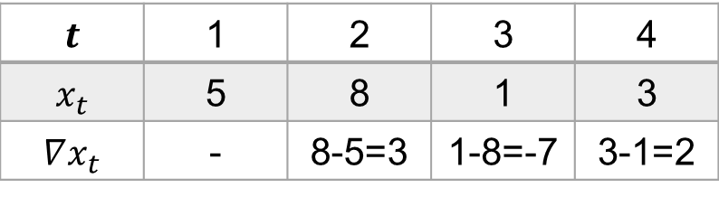
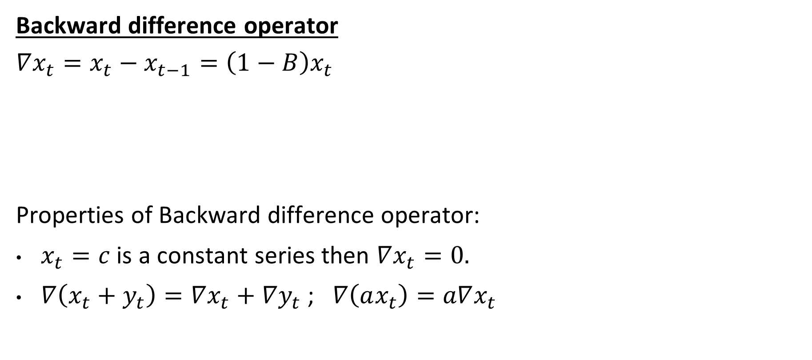
Basic manipulations with series
Backward difference operator
$∇x_{t}=x_{t}−x_{t−1}=\left(1−B\right)x_{t}$
Properties of Backward difference operator:
$x_{t}=c$ is a constant series then $∇x_{t}=0.$
$∇\left(x_{t}+y_{t}\right)=∇x_{t}+∇y_{t}$ ; $∇\left(ax_{t}\right)=a∇x_{t}$
R-code
diff(x=x, lag=1)
x - lag(x, -1)
$$t$$ | 1 | 2 | 3 | 4
$$x_{t}$$ | 5 | 8 | 1 | 3
$$∇x_{t}$$ | - | 8-5=3 | 1-8=-7 | 3-1=2

Slide 16
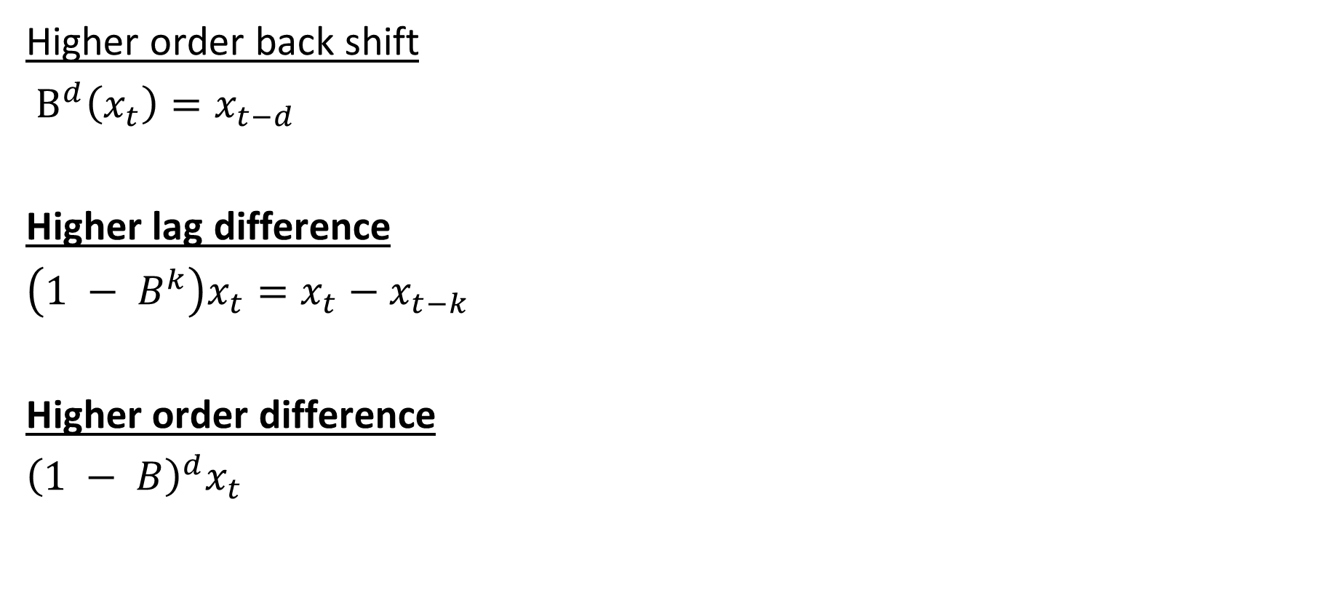
Basic manipulations with series
Higher order back shift
$B^{d}\left(x_{t}\right)=x_{t−d}$
Higher lag difference
$\left(1 − B^{k}\right)x_{t}=x_{t}−x_{t−k}$
Higher order difference
${\left(1 − B\right)}^{d}x_{t}$
R-code:
d=5
lag(x = x, k = -d)
k=5
diff(x, lag = k)
d = 5
diff(x, differences = d)

Slide 17
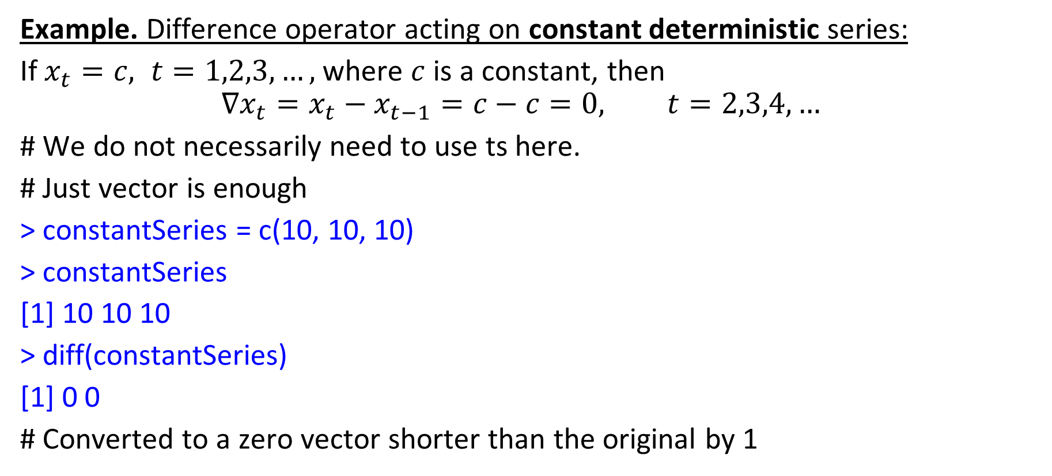
Basic manipulations with series
Example. Difference operator acting on constant deterministic series:
If $x_{t}=c, t=1,2,3,…,$ where $c$ is a constant, then
$$∇x_{t}=x_{t}−x_{t−1}=c−c=0, t=2,3,4,…$$
# We do not necessarily need to use ts here.
# Just vector is enough
> constantSeries = c(10, 10, 10)
> constantSeries
[1] 10 10 10
> diff(constantSeries)
[1] 0 0
# Converted to a zero vector shorter than the original by 1

Slide 18
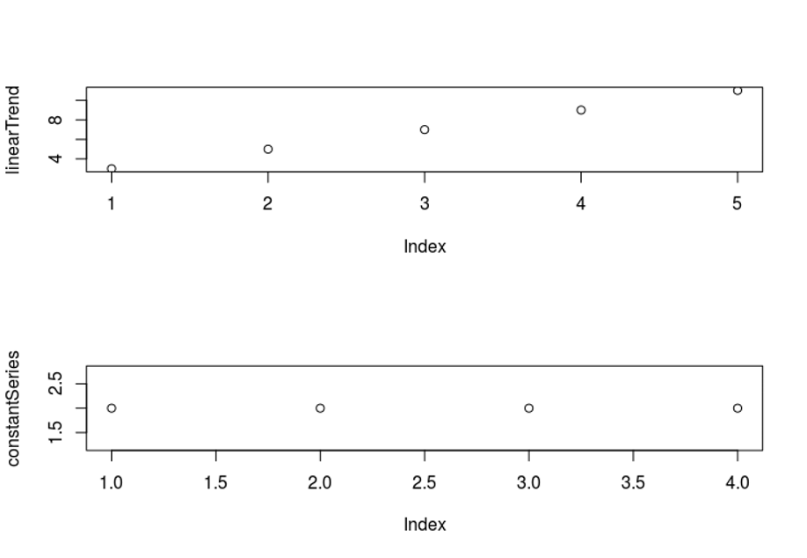
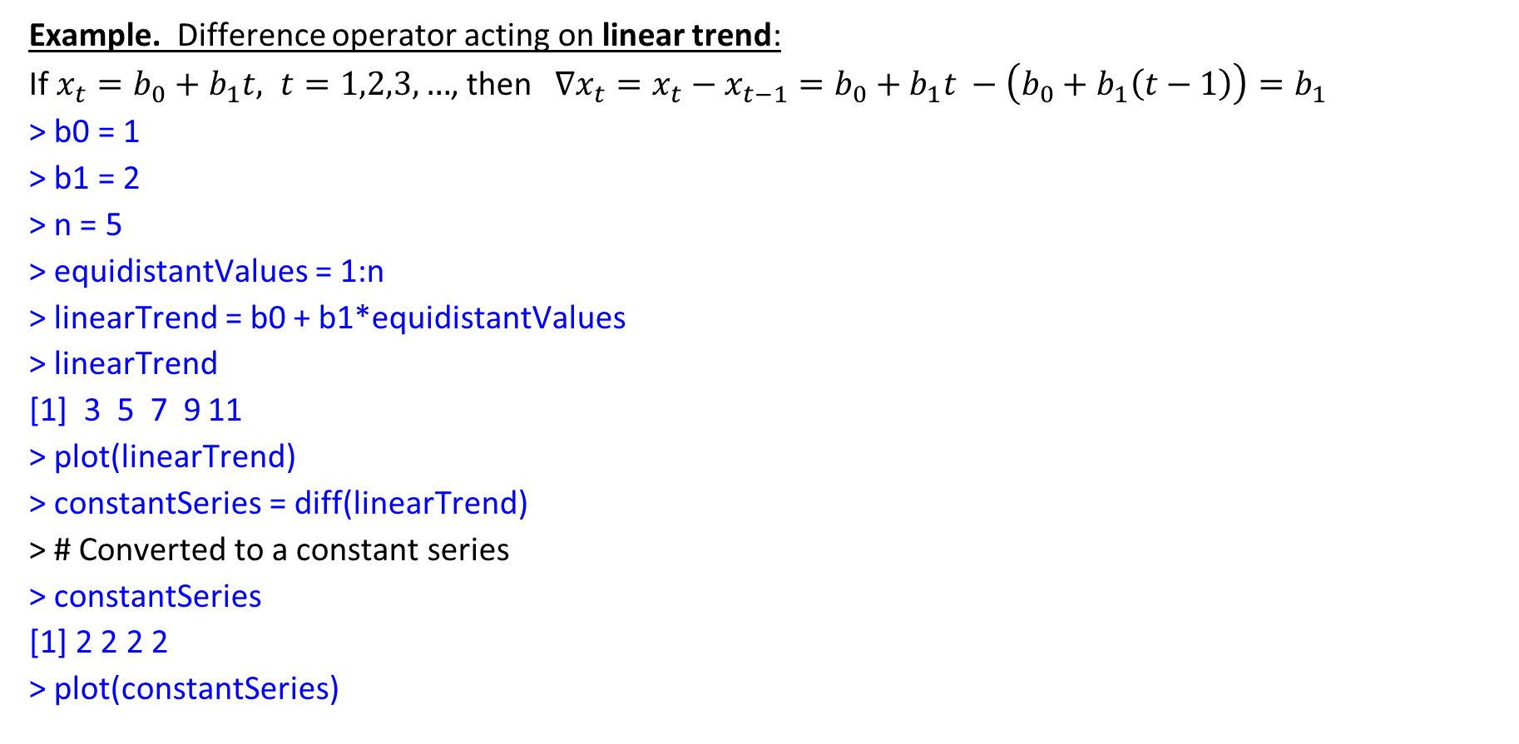
Basic manipulations with series
Example. Difference operator acting on linear trend:
If $x_{t}=b_{0}+b_{1}t, t=1,2,3,…$, then$∇x_{t}=x_{t}−x_{t−1}=b_{0}+b_{1}t −\left(b_{0}+b_{1}\left(t−1\right)\right)=b_{1}$
> b0 = 1
> b1 = 2
> n = 5
> equidistantValues = 1:n
> linearTrend = b0 + b1*equidistantValues
> linearTrend
[1] 3 5 7 9 11
> plot(linearTrend)
> constantSeries = diff(linearTrend)
> # Converted to a constant series
> constantSeries
[1] 2 2 2 2
> plot(constantSeries)

Slide 19
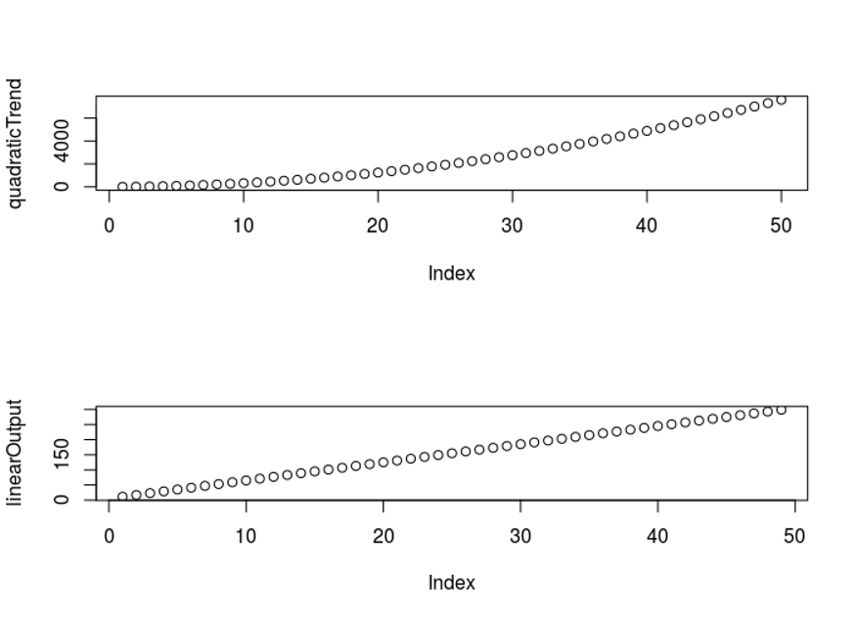
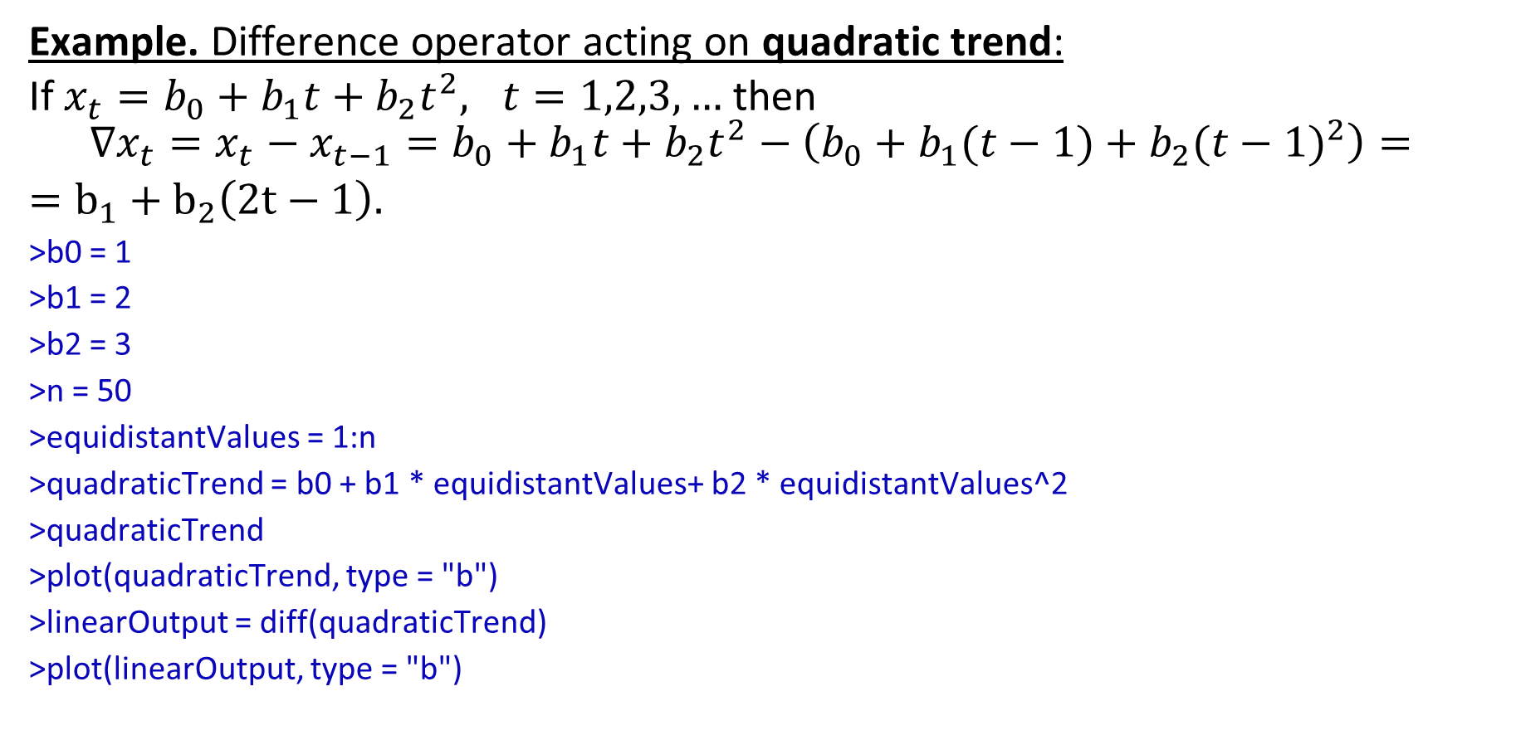
Basic manipulations with series
Example. Difference operator acting on quadratic trend:
If $x_{t}=b_{0}+b_{1}t+b_{2}t^{2}, t=1,2,3,…$ then
$$∇x_{t}=x_{t}−x_{t−1}=b_{0}+b_{1}t+b_{2}t^{2}−\left(b_{0}+b_{1}(t−1)+b_{2}({t−1)}^{2}\right)=$$
$=b_{1}+b_{2}\left(2t−1\right).$
>b0 = 1
>b1 = 2
>b2 = 3
>n = 50
>equidistantValues = 1:n
>quadraticTrend = b0 + b1 * equidistantValues+ b2 * equidistantValues^2
>quadraticTrend
>plot(quadraticTrend, type = "b")
>linearOutput = diff(quadraticTrend)
>plot(linearOutput, type = "b")

Slide 20
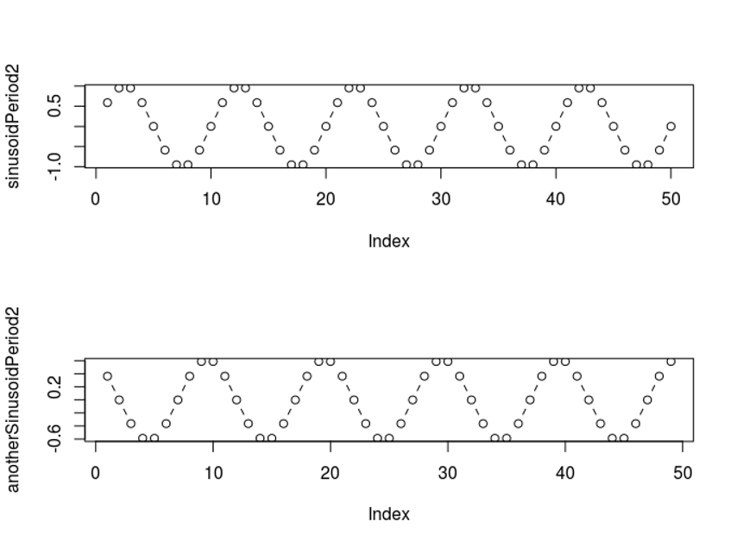
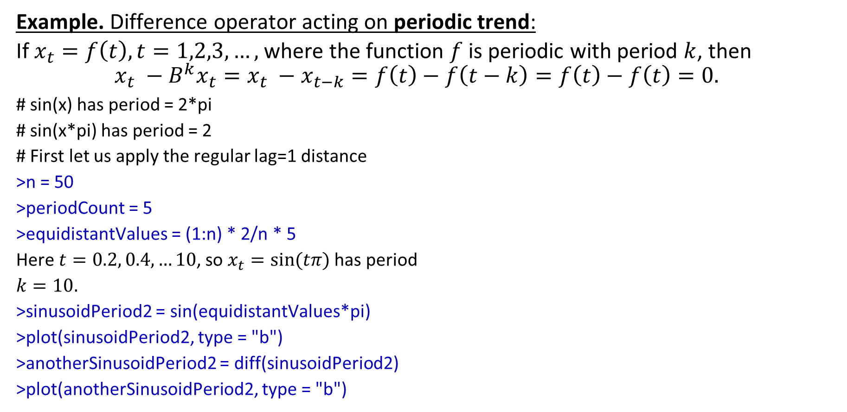
Basic manipulations with series
Example. Difference operator acting on periodic trend:
If $x_{t}=f\left(t\right), t=1,2,3,…,$ where the function $f$ is periodic with period $k$, then
$${x_{t} −B}^{k}x_{t}=x_{t} −x_{t−k}=f\left(t\right)−f\left(t−k\right)=f\left(t\right)−f\left(t\right)=0.$$
# sin(x) has period = 2*pi
# sin(x*pi) has period = 2
# First let us apply the regular lag=1 distance
>n = 50
>periodCount = 5
>equidistantValues = (1:n) * 2/n * 5
Here $t=0.2, 0.4,…10$, so $x_{t}=sin⁡(tπ)$ has period
$k=10.$
>sinusoidPeriod2 = sin(equidistantValues*pi)
>plot(sinusoidPeriod2, type = "b")
>anotherSinusoidPeriod2 = diff(sinusoidPeriod2)
>plot(anotherSinusoidPeriod2, type = "b")

Slide 21
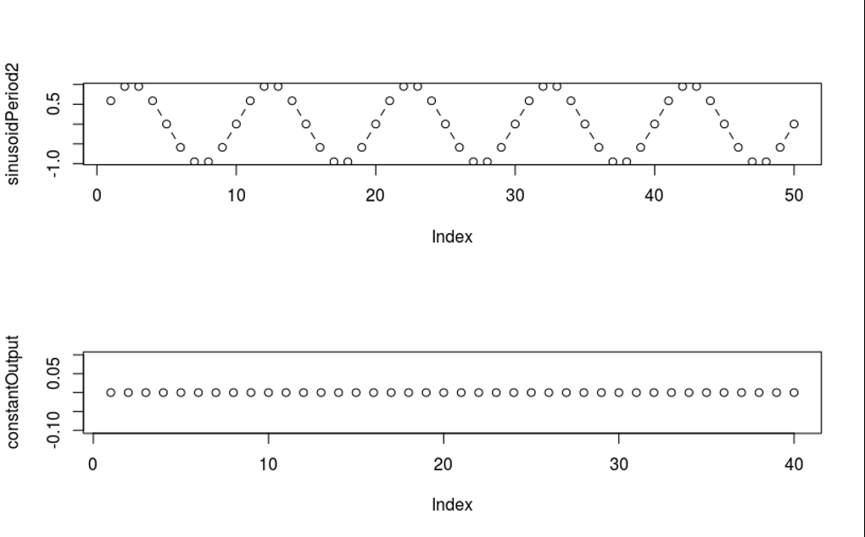
Basic manipulations with series
Example. Difference operator with lag k acting on periodic trend:
# to make it constant, we need a difference of lag of a period size
# Now the period is 10 elementary intervals
par(mfrow = c(2,1))
plot(sinusoidPeriod2, type = "b")
# both - dots and lines
constantOutput = diff(sinusoidPeriod2, lag=10)
constantOutput
plot(constantOutput, type = "b")

Slide 22
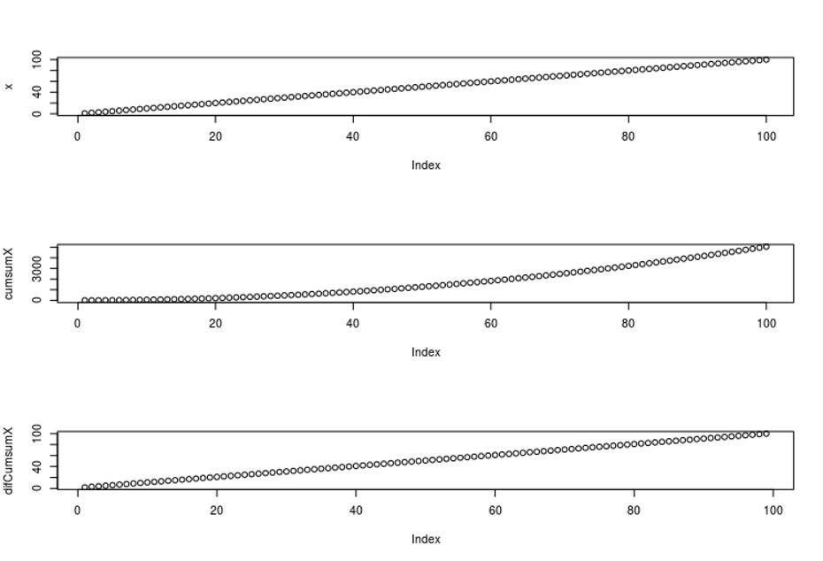
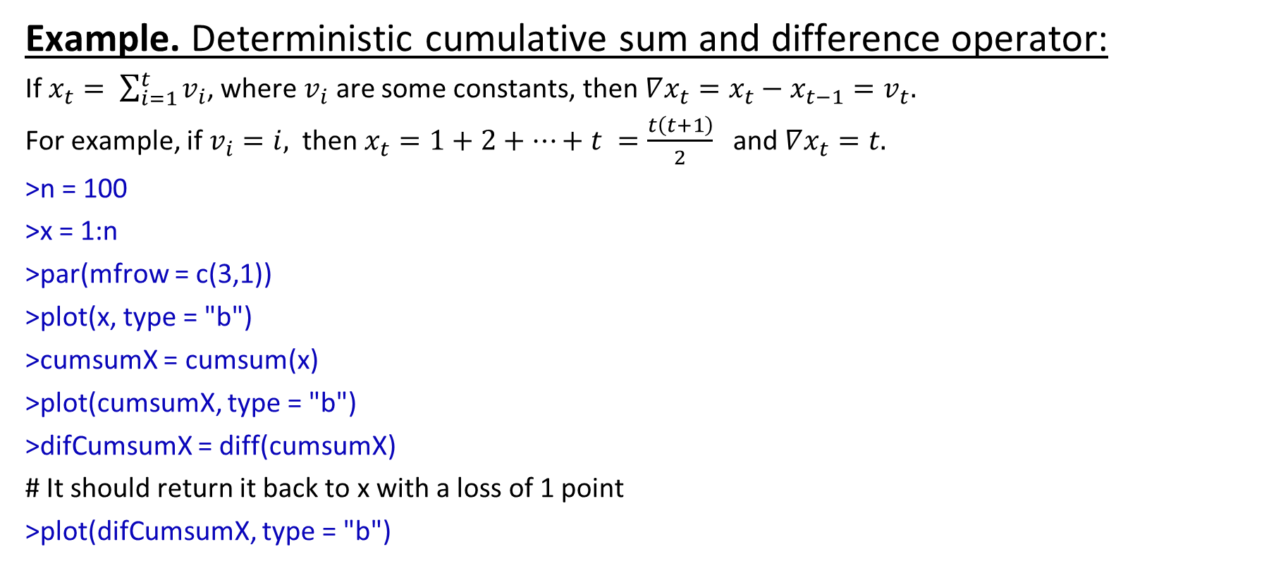
Basic manipulations with series
Example. Deterministic cumulative sum and difference operator:
If $x_{t}= \sum_{i=1}^{t}{v_{i}}$, where $v_{i}$ are some constants, then $∇x_{t}=x_{t}−x_{t−1}=v_{t}.$
For example, if $v_{i}=i,$ then $x_{t}=1+2+…+t =\frac{t\left(t+1\right)}{2}$ and $∇x_{t}=t.$
>n = 100
>x = 1:n
>par(mfrow = c(3,1))
>plot(x, type = "b")
>cumsumX = cumsum(x)
>plot(cumsumX, type = "b")
>difCumsumX = diff(cumsumX)
# It should return it back to x with a loss of 1 point
>plot(difCumsumX, type = "b")

Slide 23
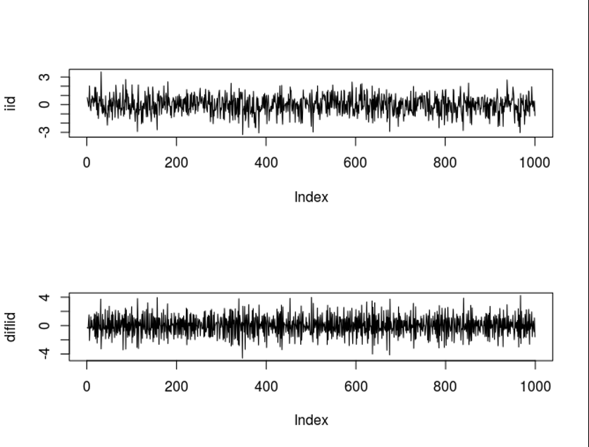
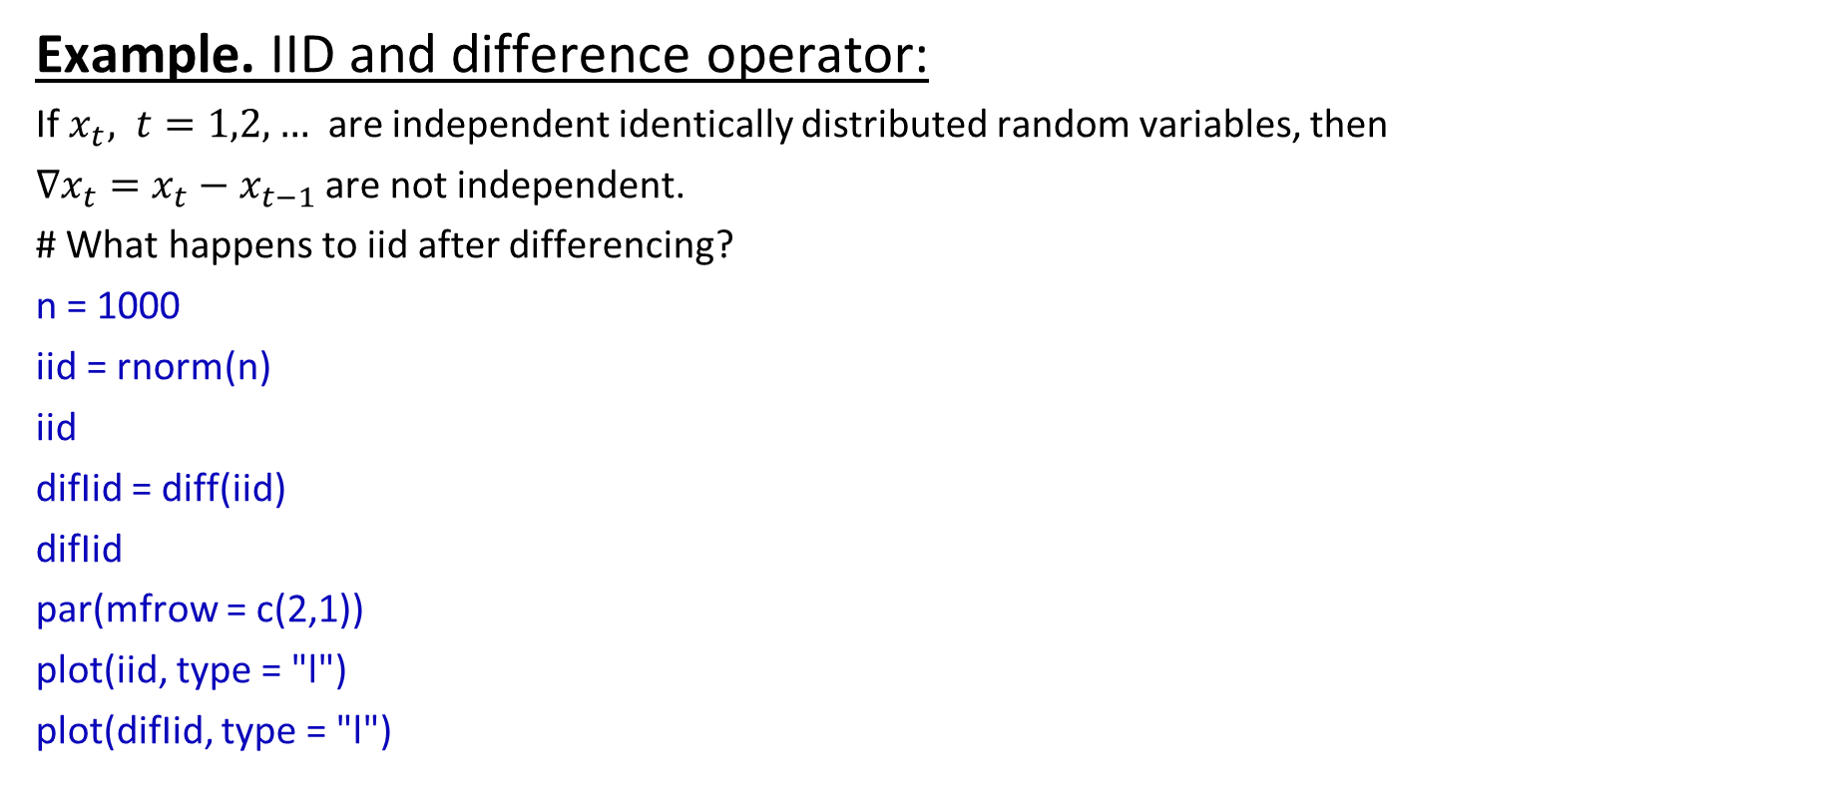
Basic manipulations with series
Example. IID and difference operator:
If $x_{t}, t=1,2,…$ are independent identically distributed random variables, then
$∇x_{t}=x_{t}−x_{t−1}$ are not independent.
# What happens to iid after differencing?
n = 1000
iid = rnorm(n)
iid
difIid = diff(iid)
difIid
par(mfrow = c(2,1))
plot(iid, type = "l")
plot(difIid, type = "l")

Slide 24
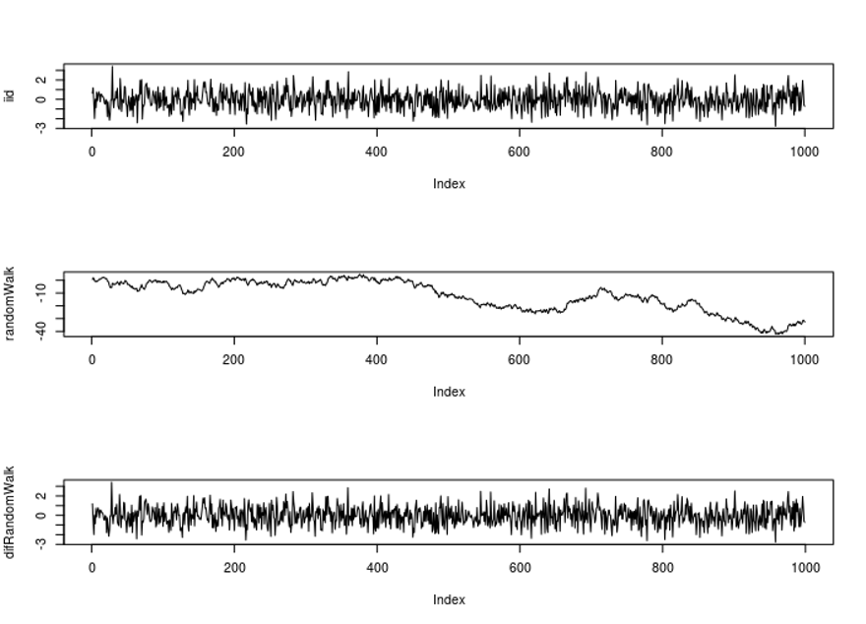
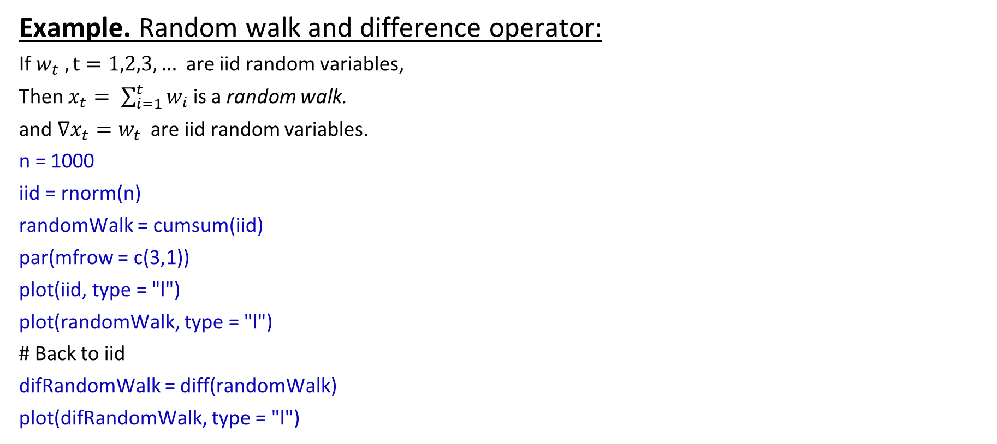
Basic manipulations with series
Example. Random walk and difference operator:
If $w_{t} , t=1,2,3,…$ are iid random variables,
Then $x_{t}= \sum_{i=1}^{t}{w_{i}}$ is a random walk.
and $∇x_{t}=w_{t}$ are iid random variables.
n = 1000
iid = rnorm(n)
randomWalk = cumsum(iid)
par(mfrow = c(3,1))
plot(iid, type = "l")
plot(randomWalk, type = "l")
# Back to iid
difRandomWalk = diff(randomWalk)
plot(difRandomWalk, type = "l")

Slide 25
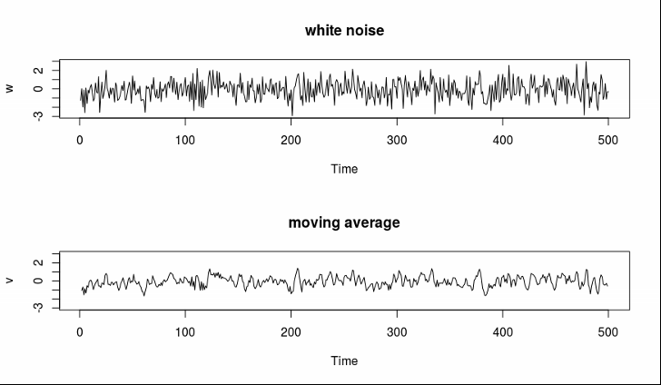
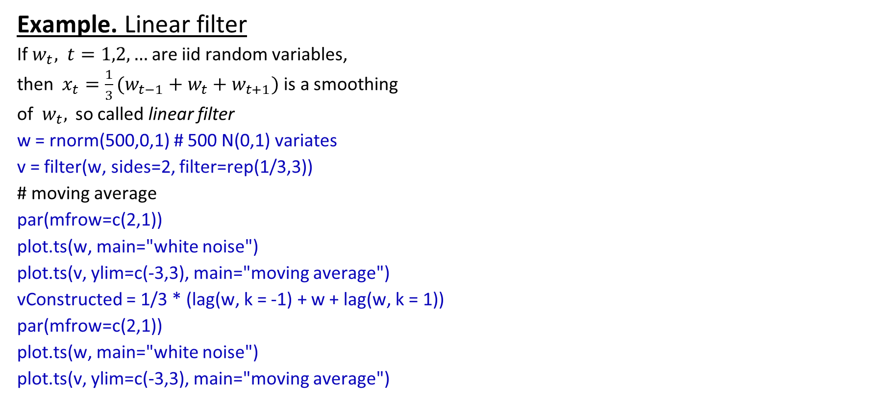
Basic manipulations with series
Example. Linear filter
If $w_{t}, t=1,2,…$ are iid random variables,
then $x_{t}=\frac{1}{3}(w_{t−1}+w_{t}+w_{t+1})$ is a smoothing
of $w_{t},$ so called linear filter
w = rnorm(500,0,1) # 500 N(0,1) variates
v = filter(w, sides=2, filter=rep(1/3,3))
# moving average
par(mfrow=c(2,1))
plot.ts(w, main="white noise")
plot.ts(v, ylim=c(-3,3), main="moving average")
vConstructed = 1/3 * (lag(w, k = -1) + w + lag(w, k = 1))
par(mfrow=c(2,1))
plot.ts(w, main="white noise")
plot.ts(v, ylim=c(-3,3), main="moving average")

Slide 26
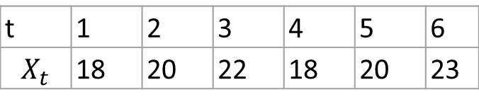
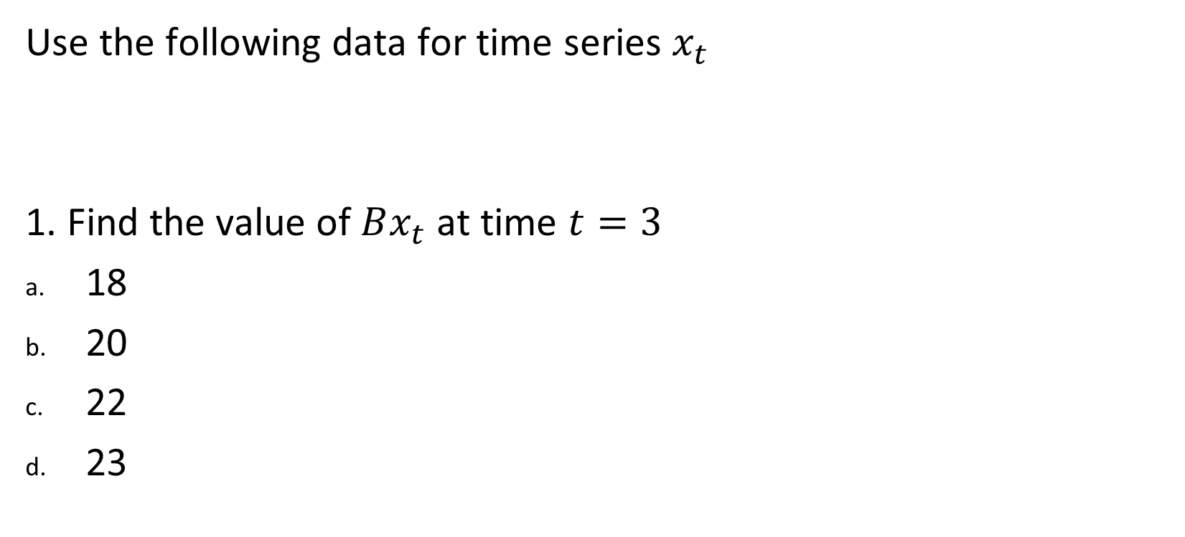
Quiz and midterm practice
Use the following data for time series $x_{t}$
1. Find the value of $Bx_{t}$ at time $t=3$
18
20
22
23
t | 1 | 2 | 3 | 4 | 5 | 6
$$X_{t}$$ | 18 | 20 | 22 | 18 | 20 | 23

Slide 27
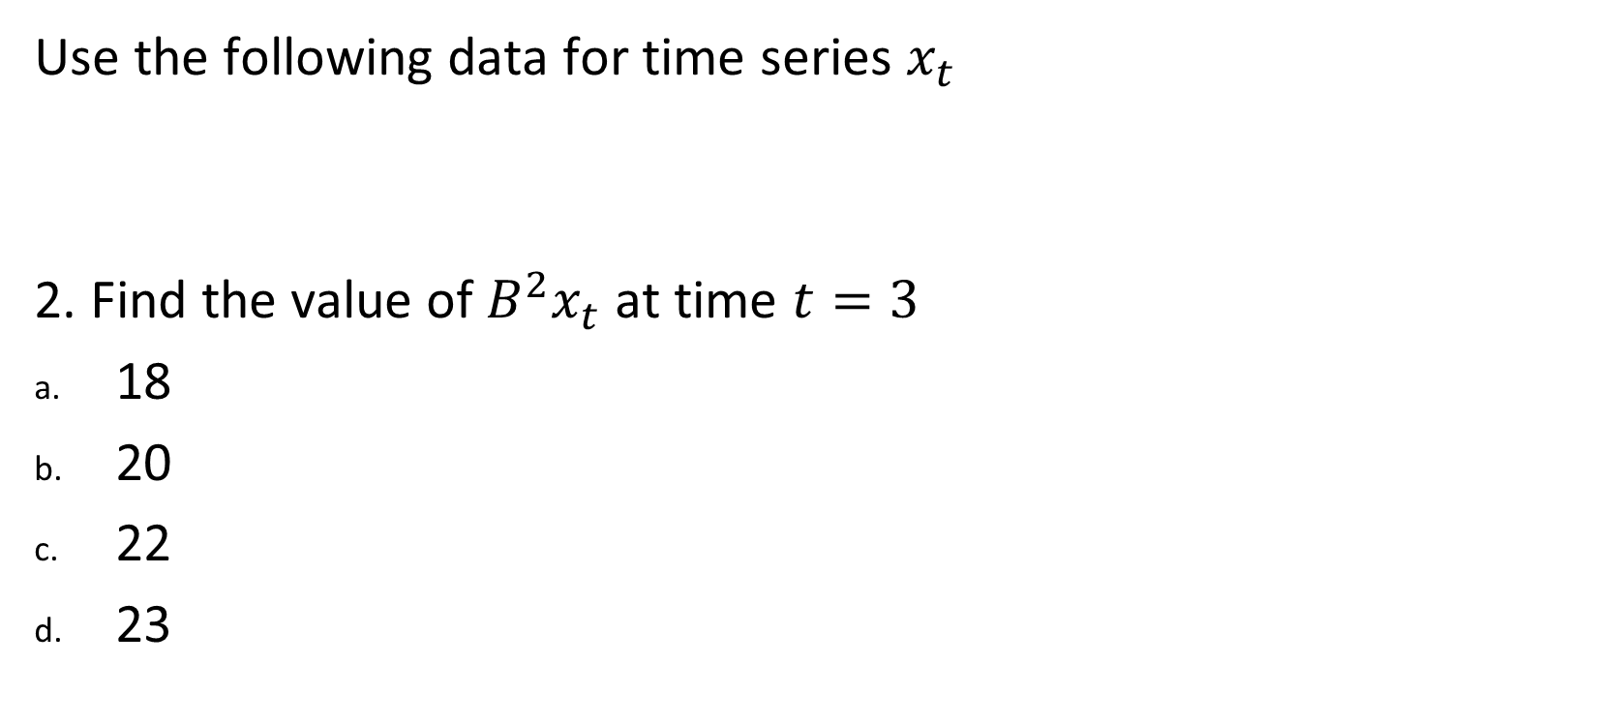
Quiz and midterm practice
Use the following data for time series $x_{t}$
2. Find the value of $B^{2}x_{t}$ at time $t=3$
18
20
22
23
t | 1 | 2 | 3 | 4 | 5 | 6
$$X_{t}$$ | 18 | 20 | 22 | 18 | 20 | 23

Slide 28
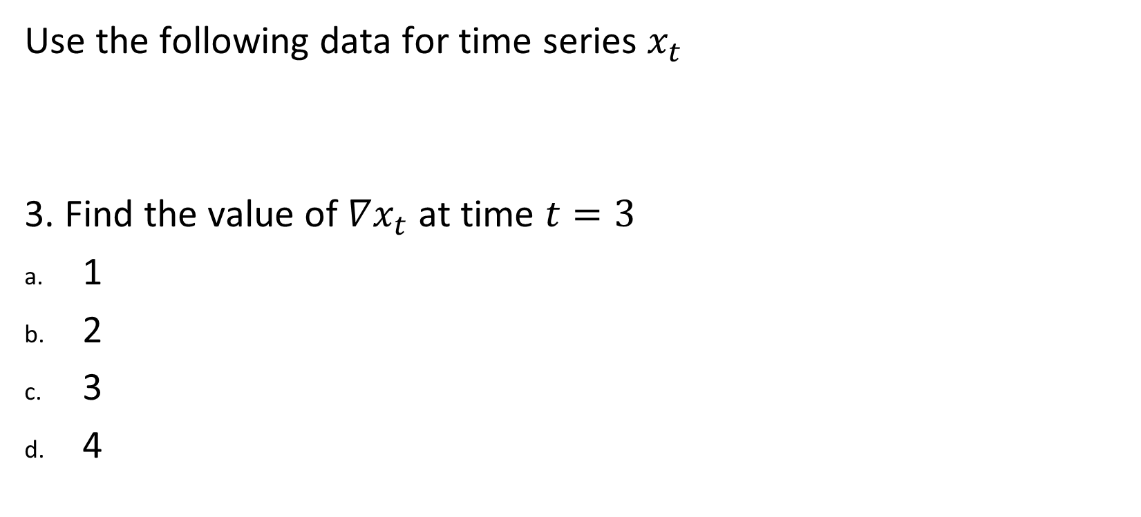
Quiz and midterm practice
Use the following data for time series $x_{t}$
3. Find the value of $∇x_{t}$ at time $t=3$
1
2
3
4
t | 1 | 2 | 3 | 4 | 5 | 6
$$X_{t}$$ | 18 | 20 | 22 | 18 | 20 | 23

Slide 29
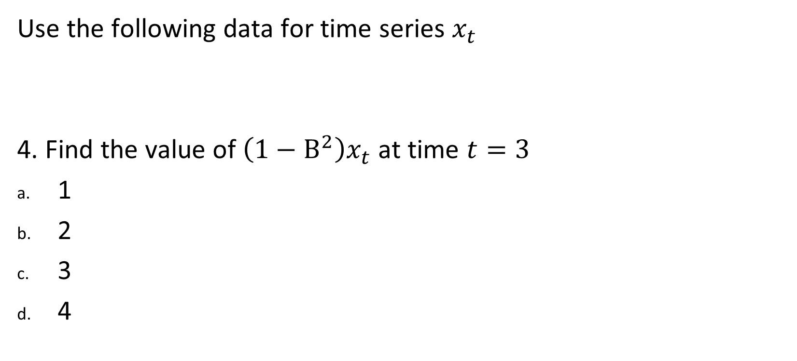
Quiz and midterm practice
Use the following data for time series $x_{t}$
4. Find the value of $\left(1−B^{2}\right)x_{t}$ at time $t=3$
1
2
3
4
t | 1 | 2 | 3 | 4 | 5 | 6
$$X_{t}$$ | 18 | 20 | 22 | 18 | 20 | 23

Slide 30
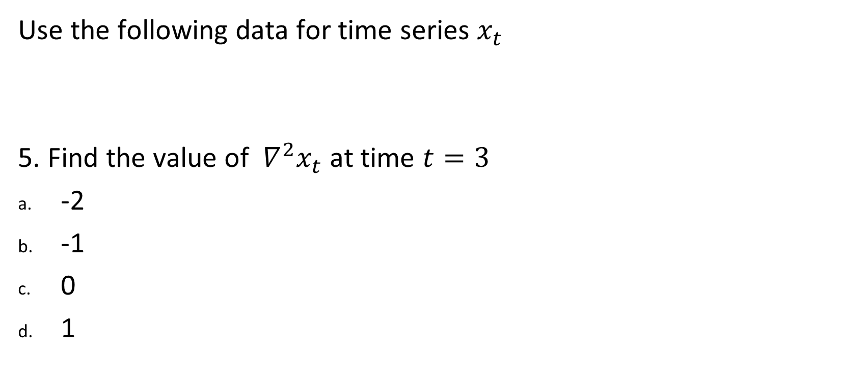
Quiz and midterm practice
Use the following data for time series $x_{t}$
5. Find the value of $∇^{2}x_{t}$ at time $t=3$
-2
-1
0
1
t | 1 | 2 | 3 | 4 | 5 | 6
$$X_{t}$$ | 18 | 20 | 22 | 18 | 20 | 23

Slide 31
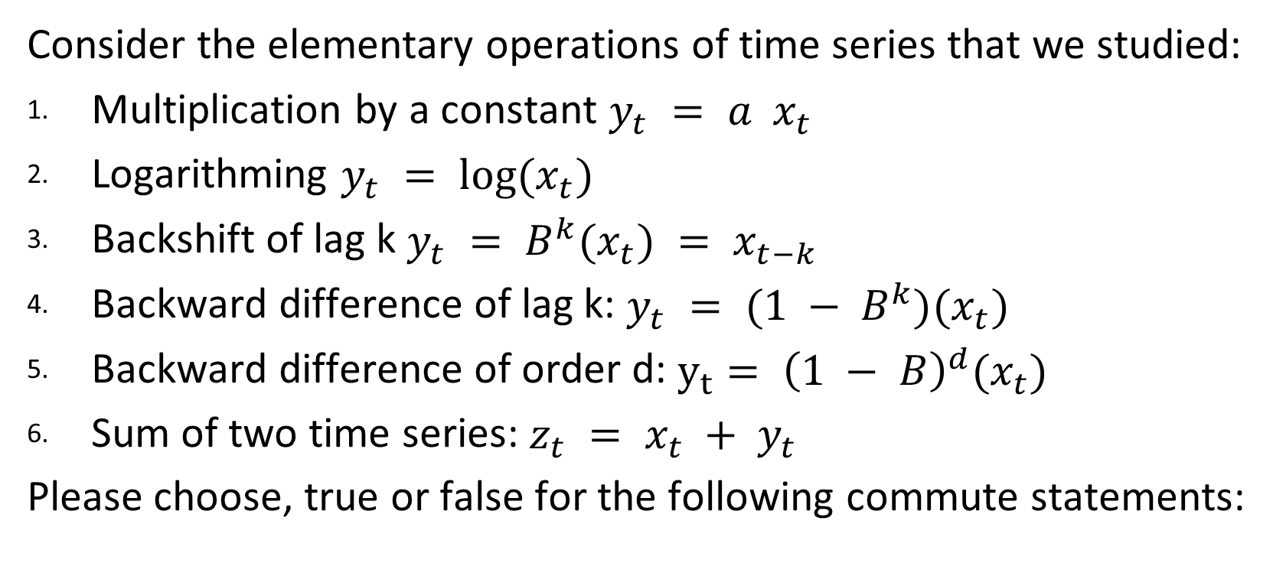
Quiz and midterm practice
Consider the elementary operations of time series that we studied:
Multiplication by a constant $y_{t} = a x_{t}$
Logarithming $y_{t} = log⁡(x_{t})$
Backshift of lag k $y_{t} = B^{k}(x_{t}) = x_{t−k}$
Backward difference of lag k: $y_{t} = (1 − B^{k})(x_{t})$
Backward difference of order d: $y_{t}= {\left(1 − B\right)}^{d}(x_{t})$
Sum of two time series: $z_{t} = x_{t} + y_{t}$
Please choose, true or false for the following commute statements:

Slide 32
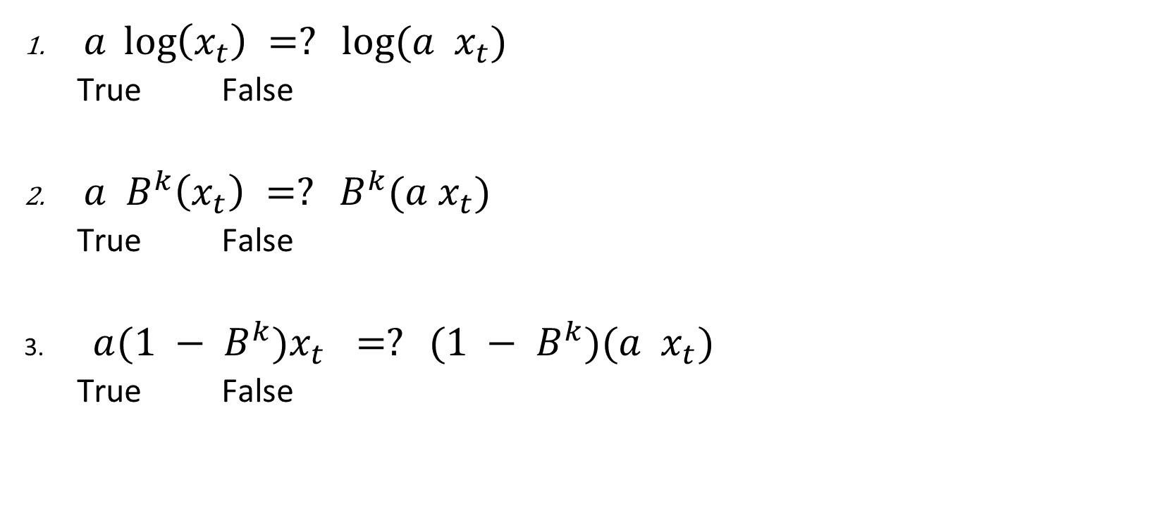
Quiz and midterm practice
$a \log\left(x_{t}\right) =? log⁡(a x_{t})$
True False
$a B^{k}\left(x_{t}\right) =? B^{k}(a x_{t})$
True False
$a(1 − B^{k})x_{t}$ $=? (1 − B^{k})(a x_{t})$
True False

Slide 33
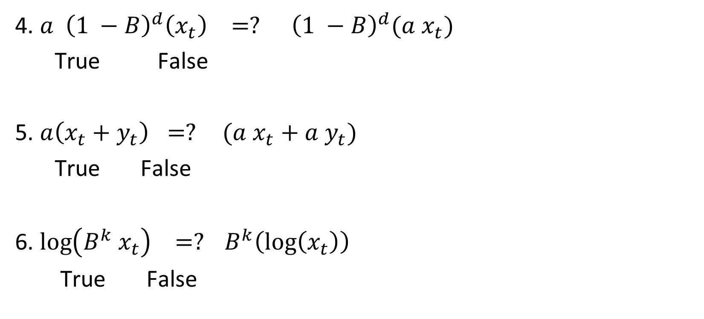
Quiz and midterm practice
4. $a {\left(1 −B\right)}^{d}\left(x_{t}\right) =? {\left(1 −B\right)}^{d}({a x}_{t})$
True False
5. $a\left(x_{t}+y_{t}\right) =? (a x_{t}+a{ y}_{t})$
True False
6. $\log\left(B^{k} x_{t}\right) =? B^{k}\left(\log\left(x_{t}\right)\right)$
True False

Slide 34
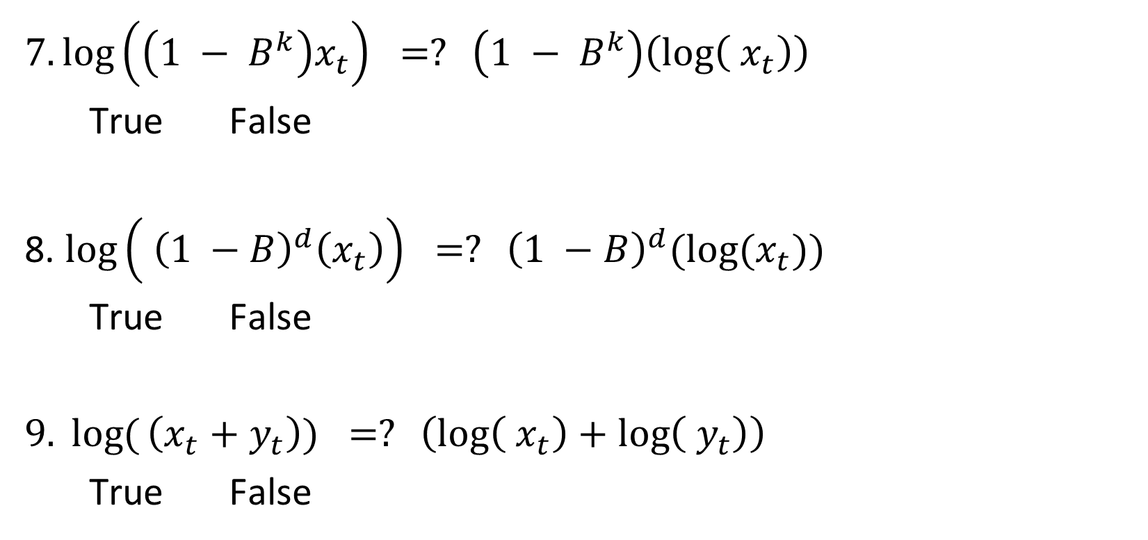
Quiz and midterm practice
$7. \log\left(\left(1 − B^{k}\right)x_{t}\right) =? \left(1 − B^{k}\right)\left(\log\left( x_{t}\right)\right)$
True False
8. $\log\left( {\left(1 −B\right)}^{d}\left(x_{t}\right)\right) =? {\left(1 −B\right)}^{d}({log⁡(x}_{t}))$
True False
$9. log{(}\left(x_{t}+y_{t}\right)) =? \left(\log\left( x_{t}\right)+\log\left({ y}_{t}\right)\right)$
True False

Slide 35
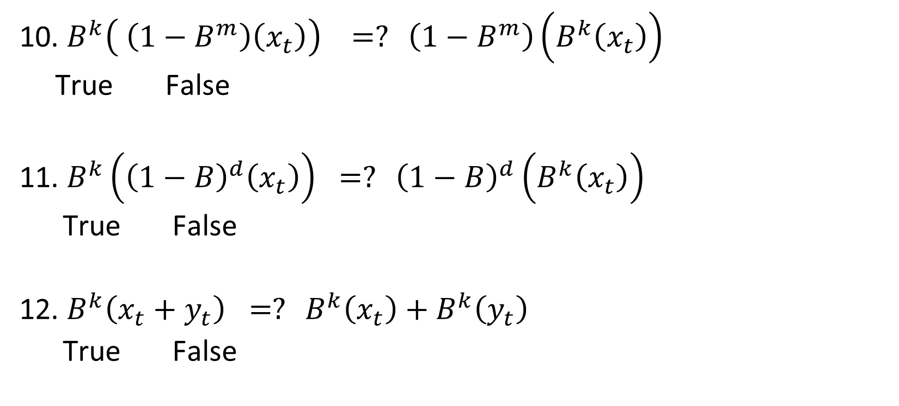
Quiz and midterm practice
10. $B^{k}\left( \left(1−B^{m}\right)\left(x_{t}\right)\right) =? \left(1−B^{m}\right)\left(B^{k}\left(x_{t}\right)\right)$
True False
11. $B^{k}\left({\left(1−B\right)}^{d}\left(x_{t}\right)\right) =? {\left(1−B\right)}^{d}\left(B^{k}\left(x_{t}\right)\right)$
True False
12. $B^{k}\left(x_{t}+y_{t}\right) =? B^{k}\left(x_{t}\right)+B^{k}\left(y_{t}\right)$
True False

Slide 36
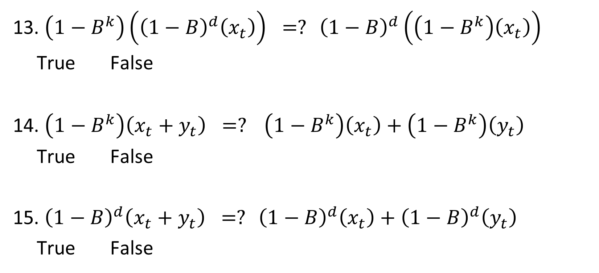
Quiz and midterm practice
13. $\left(1−B^{k}\right)\left({\left(1−B\right)}^{d}\left(x_{t}\right)\right) =? {\left(1−B\right)}^{d}\left(\left(1−B^{k}\right)\left(x_{t}\right)\right)$
True False
14. $\left(1−B^{k}\right)\left(x_{t}+y_{t}\right) =? \left(1−B^{k}\right)\left(x_{t}\right)+\left(1−B^{k}\right)\left(y_{t}\right)$
True False
15. ${\left(1−B\right)}^{d}\left(x_{t}+y_{t}\right) =? {\left(1−B\right)}^{d}\left(x_{t}\right)+{\left(1−B\right)}^{d}\left(y_{t}\right)$
True False

Slide 37
Quiz and midterm practice
Suppose that we have the following time-series x <- ts(11:15) How can we perform backshift?
lag(x)
lag(x, k = 1)
lag(x, k = -1)
diff(x)
We want to backshift time series x <- ts(11:15) by 2. Which R function should we use?
lag(x)
lag(x, k = 2)
lag(x, k = -2)
lag(x, units = 2)

Slide 38

Quiz and midterm practice
If we want to difference a series x <- ts(1:5) as follows ${∇x}_{t} =x_{t}−x_{t−1},$which R function should we use?
diff(x)
diff(x, lag = 2)
lag(x, k = 1)
diff(x, diff = 2)
We have time-series x <- ts(101:105) and want to find difference $∇^{2}x_{t}.$Which R function should we use?
diff(x)
diff(x, lag = 2, diff = 2)
diff(x, diff = 2)
diff(x, lag = 2)

Slide 39
Quiz and midterm practice
We have the following code:
x <- ts(101:103, start = 10)
ts.intersect(x, lag(x, k = -1))
What will be the output?
11 102 101
12 103 102
10 101 NA
11 102 101
12 103 102
13 NA 103
101
102
103
Error in ts.intersect(x, lag(x, k = -1)): could not find function "ts.intersect"

Slide 40
Quiz and midterm practice
What will be the output for the following code?
x <- ts(11:15)
filter(x, sides = 2, filter = rep(1/2, 2))
11 12 13 14 15
7.666667 8.333333 9.000000 9.666667 NA
NA 12 13 14 NA
11.5 12.5 13.5 14.5 NA

Slide 41



Example 1.8 White Noise
White Noise is a collection of uncorrelated random variables, ${\{w}_{t}\},$ with mean 0 and finite variance$σ_{w}^{2}$
Notation: $w_{t}∼wn\left(0,σ_{w}^{2}\right)$
White independent noise or iid noise is a collection of independent and identically distributed (iid) random variables with mean 0 and finite variance$σ_{w}^{2}$
Notation: $w_{t}∼iid\left(0,σ_{w}^{2}\right)$
```
Gaussian white noise is a collection of independent normal random variables, with mean 0 and finite variance$σ_{w}^{2}$
Notation: $w_{t}∼iidN\left(0,σ_{w}^{2}\right)$

Slide 42

Quiz and midterm practice
Which of the following is one of the properties of white noise?
Let $\left\{w_{t}, t=1,2,3,…\right\}$ be a white noise. True or False:
1. Random variables $w_{t}$ have the same variance for every t.
a. True
b. False
2. Random variables $w_{t}$ and $w_{s}$ are uncorrelated for $t≠s.$
a. True
b. False
3. Mean of random variables $w_{t}$ is non-zero.
a. True
b. False
4$. w_{t}−w_{s}=0$ for every $t, s.$
a. True
b. False

Slide 43


Example 1.9 Moving Averages and Filtering
a moving average smoothes the series.
Example: $v_{t}=\frac{1}{3}(w_{t−1}+w_{t}+w_{t+1})$, where $w_{t}∼wn\left(0,σ_{w}^{2}\right)$
A linear combination of values in a time series is referred to, generically, as a filtered series;
R-code
w = rnorm(500,0,1) # 500 N(0,1) variates
v = filter(w, sides=2, filter=rep(1/3,3)) # moving average

Slide 44


Example 1.10 Autoregression
Example $x_{t}=x_{t−1}−0.9x_{t−2}+w_{t}$, where $w_{t}∼wn\left(0,σ_{w}^{2}\right)$
represents a regression or prediction of the current value $x_{t}$of a time series as a function of the past two values of the series, and, hence, the term autoregression is suggested for this model.
R-code
w = rnorm(550,0,1) # 50 extra to avoid startup problems
x = filter(w, filter=c(1,-.9), method="recursive")[-(1:50)] # remove first 50
tsplot(x, main="autoregression")

Slide 45



Example 1.11 Random Walk with Drift
random walk with drift model given by $x_{t}=δ+x_{t−1}+w_{t}$, where
$w_{t}$is white noise,
$δ$ is a drift
we may rewrite equation as a cumulative sum of white noise variates:
$$x_{t}=δt+\sum_{j=1}^{t}{w_{j}}$$
R-code
set.seed(154) # so you can reproduce the results
w = rnorm(200); x = cumsum(w) # two commands in one line
wd = w +.2; xd = cumsum(wd)

Slide 46


Example 1.12 Signal in Noise
20:31
Many realistic models for generating time series assume an underlying signal with
some consistent periodic variation, contaminated by adding a random noise.
Example: $x_{t}=2\cos\left(2π\frac{t+15}{50} \right)+w_{t}$
R-code
cs = 2*cos(2*pi*1:500/50 + .6*pi);
w = rnorm(500,0,1)
par(mfrow=c(3,1), mar=c(3,2,2,1), cex.main=1.5)
plot.ts(cs+w, main=expression(2*cos(2*pi*t/50+.6*pi) + N(0,1)))
plot.ts(cs+5*w, main=expression(2*cos(2*pi*t/50+.6*pi) + N(0,25)))

Slide 47
Chapter 1 Characteristics of Time Series
1.3 Measures of Dependence

Slide 48



The mean function
Definition 1.1 The mean function is defined as
$$μ_{xt}=E\left(x_{t}\right)=\int_{−∞}^{+∞}{xf_{t}\left(x\right)dx}$$
provided it exists, where E denotes the usual expected value operator.
When no confusion exists about which time series we are referring to, we will drop a subscript and write
$μ_{xt}$ as $μ_{t}$
Example 1.13 Mean Function of a Moving Average Series $v_{t}=\frac{1}{3}\left(w_{t−1}+w_{t}+w_{t+1}\right)$
$$μ_{νt}=E\left(ν_{t}\right)=\frac{1}{3}\left[E\left(w_{t−1}\right)+E{(w}_{t}\right)+E(w_{t+1})]=0$$
Example 1.14 Mean Function of a Random Walk with Drift $x_{t}=δt+\sum_{j=1}^{t}{w_{j}}$
$$μ_{xt}=E\left(x_{t}\right)=δt+\sum_{j=1}^{t}{E(w_{j})}=δt.$$

Slide 49



The autocovariance function
Definition 1.1 The autocovariance function is defined as the second moment product
$$γ_{x}\left(s,t\right)=cov\left(x_{s}, x_{t}\right)=E\left[(x_{s}−μ_{s})(x_{t}−μ_{t})\right],$$
for all s and t .
When no possible confusion exists about which time series we are referring to, we will drop the subscript and write$γ_{x}\left(s,t\right)$ as $γ\left(s,t\right).$
Note that $γ_{x}\left(s,t\right)=γ_{x}(t,s)$ at all time points s and t .
Example 1.16 Autocovariance of White Noise
$$γ_{w}\left(s,t\right)=cov\left(w_{s}, w_{t}\right)= \left\{\begin{aligned}σ_{w}^{2}, s=t, \\ 0, s≠t.\end{aligned}\right.$$
Property 1.1 Covariance of Linear Combinations. If the random variables $U=\sum_{j=1}^{m}{a_{j}X_{j}}$ and $U=\sum_{k=1}^{r}{b_{k}Y_{k}}$ linear combinations of (finite variance) random variables $\left\{X_{j}\right\}$ and $\left\{Y_{k}\right\}$ then
$$cov\left(U,V\right)= \sum_{j=1}^{m}{\sum_{k=1}^{r}{a_{j}b_{k}cov\left(X_{j}, Y_{k}\right)}}$$

Slide 50

The autocovariance function
Example 1.18 Autocovariance of a Random Walk
For the random walk model, $x_{t}=δt+\sum_{j=1}^{t}{w_{j}}$ we have
$$γ_{x\left(s,t\right)}=cov\left(x_{s}, x_{t}\right)=cov\left(\sum_{j=1}^{s}{w_{j},\sum_{j=1}^{t}{w_{k}}}\right)=\min\left\{s,t\right\}σ_{w}^{2},$$
because the $w_{t}$ are uncorrelated random variables.
Definition 1.3 The autocorrelation function (ACF) is defined as
$$ρ\left(s,t\right)=\frac{γ\left(s,t\right)}{\sqrt{γ\left(s,s\right)γ(t,t)}}$$

Slide 51

The cross-covariance
Definition 1.4 The cross-covariance function between two series, $x_{t}$ and $y_{t}$ , is
$$γ_{xy}\left(s,t\right)=cov\left(x_{s}, y_{t}\right)=E\left[\left(x_{s}−μ_{xs}\right)\left(y_{t}−μ_{yt}\right)\right]$$
Definition 1.5 The cross-correlation function (CCF) is given by
$$ρ_{xy}\left(s,t\right)=\frac{γ_{xy}(s,t)}{\sqrt{γ_{x}\left(s,s\right)γ_{y}\left(t,t\right)}}$$

Slide 52

Quiz and midterm practice
Cross-covariance function
Let $w_{t}$be a white noise with variance $σ^{2}$. Consider two time series
$x_{t}=w_{t−1}+w_{t}$, $y_{t}=w_{t}−w_{t+1}$
1. Find cross-covariance function $γ_{xy}\left(s,t\right)$ when $s=3, t=1.$
$−2σ^{2}$
$−σ^{2}$
0
$σ^{2}$
$2σ^{2}$
2. Are x and y jointly stationary?
a. Yes
b. No

Slide 53
Chapter 1 Characteristics of Time Series
1.4 Stationary Time Series

Slide 54


Definitions
Definition 1.6 A strictly stationary time series is one for which the probabilistic
behavior of every collection of values
$$\left\{x_{t_{1}},x_{t_{2}},…, x_{t_{k}}\right\}$$
is identical to that of the time shifted set
$$\left\{x_{t_{1}+h},x_{t_{2}+h},…, x_{t_{k}+h}\right\}.$$
That is,
Pr$\left\{x_{{ t}_{1}}≤c_{1},x_{t_{2}}≤c_{2},…, x_{t_{k}}≤c_{k}\right\}$
for all $k=1,2,…,$ all time points $t_{1},t_{2}, …,t_{k}$, all numbers $c_{1},c_{2},…,c_{k},$ and all time shifts $h=0, ±1, ±2,$
Definition 1.7 A weakly stationary time series, $x_{t},$ is a finite variance process such that
(i) the mean value function, $μ_{t}$ is constant and does not depend on time t , and
(ii) the autocovariance function, $γ\left(s,t\right)$depends on s and t only through their difference $\left|s−t\right|.$
Henceforth, we will use the term stationary to mean weakly stationary; if a process is stationary in the strict sense, we will use the term strictly stationary.

Slide 55


Properties of stationary series
Because the mean function, $E{(x}_{t})$, of a stationary time series is independent of time t , we will write
$$μ_{t}=μ$$
The autocovariance function of a stationary time series will be written as
$$γ\left(h\right)=cov\left(x_{t+h},x_{t}\right)$$
The autocorrelation function of a stationary time series will be written as
$$ρ\left(h\right)=\frac{γ\left(h\right)}{γ\left(0\right)}.$$
Example 1.19 Stationarity of White Noise $w_{t}$
The mean and autocovariance functions of the white noise series are
$μ_{wt}=0$ (does not depend on time)
$γ_{w}\left(s,t\right)=cov\left(w_{s}, w_{t}\right)= \left\{\begin{aligned}σ_{w}^{2}, s=t, \\ 0, s≠t.\end{aligned}\right.$ (depends only on $|s−t|)$

Slide 56

More examples of stationary and non-stationary time series
Example 1.21 A Random Walk is Not Stationary
A random walk is not stationary because its autocovariance function, $γ\left(s,t\right)=\min\left\{s,t\right\}σ_{w}^{2}$ depends on time.
Also, the random walk with drift violates both conditions of Definition 1.7 because, as shown, the mean function, $μ_{xt}=δt$ , is also a function of time t .
Example 1.22 Trend Stationarity
Let $x_{t}=α+βt+y_{t},$ where $y_{t}$ is stationary.
Then$mean function μ_{xt}=α+βt+μ_{y}$ is not independent on time
But autocovariance function $γ_{x}\left(h\right)=cov\left(x_{t+h}, x_{t}\right)=γ_{y}\left(h\right)$is independent of time.

Slide 57


Several special properties of $γ(h)$ for a stationary process
$γ\left(h\right)$ is non-negative definite, that is, for any $n≥1,$ and constants $a_{1},…, a_{n}.$
$$\sum_{j=1}^{n}{\sum_{k=1}^{n}{a_{j}a_{k}γ\left(j−k\right)≥0}}$$
$\left|γ\left(h\right)\right|≤γ\left(0\right);$
$γ\left(h\right)=γ\left(−h\right);$

Slide 58



Joint stationarity
Definition 1.11 The cross-correlation function (CCF) of jointly stationary time series , $x_{t}$and $y_{t}$ is defined as
$$ρ_{xy}\left(h\right)=\frac{γ_{xy}\left(h\right)}{\sqrt{γ_{x}\left(0\right)γ_{y}\left(0\right)}}.$$
Definition 1.10 Two time series, $x_{t}$and $y_{t}$ are said to be jointly stationary if they are each stationary, and the cross-covariance function
$$γ_{xy}\left(h\right)=cov(x_{t+h},y_{t})$$
is a function only of lag h
Example 1.23 Joint Stationarity
$x_{t}=w_{t}+w_{t−1}$ and $y_{t}=w_{t}−w_{t−1}.$
We can calculate $γ_{x}\left(0\right)=γ_{y}\left(0\right)=2σ_{w}^{2}$ and $γ_{x}\left(1\right)=γ_{x}\left(−1\right)=σ_{w}^{2}, γ_{y}\left(1\right)=γ_{y}\left(−1\right)=−σ_{w}^{2}.$
$$γ_{xy}\left(1\right)=cov\left(x_{t+1},y_{t}\right)=cov\left(w_{t+1}+w_{t}, w_{t}−w_{t−1}\right)=σ_{w}^{2}$$
$$γ_{xy}\left(0\right)=0, γ_{xy}\left(−1\right)=−σ_{w}^{2}.$$
So these series are joint stationary.

Slide 59
Quiz and midterm practice
Stationarity
1. If a time series is weakly stationary then it is strictly stationary.
a. True
b. False
2. If a time series is weakly stationary, then its mean function is constant.
a. True
b. False
3. If a time series is strictly stationary then its mean function is strictly increasing function.
a. True
b. False

Slide 60
Chapter 1 Characteristics of Time Series
1.5 Estimation of Correlation

Slide 61

Sample mean
To estimate mean function of stationary series, as usual, we use sample mean
$$\overline{x}=\frac{1}{n}\sum_{t=1}^{n}{x_{t}}$$
Properties of sample mean of stationary series:
$$E\left(\overline{x}\right)=μ$$
$$var\left(\overline{x}\right)=\frac{1}{n}\sum_{h=−n}^{n}{\left(1−\frac{\left|h\right|}{n}\right)γ_{x}\left(h\right).}$$

Slide 62


Quiz and midterm practice
Sample mean.
Consider a sample of the series:
Sample mean of this sample is equal to
1
0.3
2.4
-0.1
t | 0.1 | 0.2 | 0.3 | 0.4 | 0.5
$$x_{t}$$ | -1 | 0 | 1 | 2 | 3

Slide 63


Sample autocovariance function
Definition 1.14 The sample autocovariance function is defined as
$$\hat{γ}\left(h\right)=\frac{1}{n}\sum_{t=1}^{n−h}{\left(x_{t+h}−\overline{x}\right)\left(x_{t}−\overline{x}\right)}$$
with $\hat{γ}\left(−h\right)=\hat{γ}\left(h\right)$ for $h=0,1,…,n−1.$
Definition 1.15 The sample autocorrelation function is defined as
$$\hat{ρ}\left(h\right)=\frac{\hat{γ}\left(h\right)}{\hat{γ}\left(0\right)}.$$

Slide 64

Large-Sample Distribution of the ACF
Under general conditions, if $x_{t}$ is white noise, then for n large, the sample ACF, $\hat{ρ}\left(h\right),$ for $h=1,2,…H,$ (where H is fixed but arbitrary), is approximately normally distributed with zero mean and standard deviation given by $σ_{\hat{ρ}}=\frac{1}{\sqrt{n}}.$
$$\hat{ρ}\left(h\right)≈N\left(0,\frac{1}{\sqrt{n}}\right)$$
Based on this result, we obtain a rough method of assessing whether peaks
in $\hat{ρ}\left(h\right)$ are significant by determining whether the observed peak is outside the interval $±2/\sqrt{n}$ (or plus/minus two standard errors); for a white noise sequence, approximately 95% of the sample ACFs should be within these limits.

Slide 65


Examples
Example 1.25 Sample ACF and Scatterplots
Estimating autocorrelation is similar to estimating correlation in the usual setup, where we have pairs of observations, $(x_{i}, y_{i} ),$for $i = 1, . . . , n$.
For example, if we have time series data $x_{t}$ for $t = 1, . . . , n$, then the pairs of observations for estimating $ρ(h)$are the $n − h$ pairs given by $\{\left(x_{t}, x_{t+h} \right)\};$
R-code
(r = round(acf(soi, 6, plot=FALSE)$acf[-1], 3)) # first 6 sample acf values
[1] 0.604 0.374 0.214 0.050 -0.107 -0.187
par(mfrow=c(1,2))
plot(lag(soi,-1), soi); legend('topleft', legend=r[1])
plot(lag(soi,-6), soi); legend('topleft', legend=r[6])

Slide 66


Example 1.26 A Simulated Time Series
To compare the sample ACF for various sample sizes to the theoretical ACF, consider a contrived set of data generated by tossing a fair coin, letting $x_{t} = 1$when a head is obtained and $x_{t} = −1$when a tail is obtained. Then, construct $y_{t}$ as
$$y_{t} = 5 + x_{t} −0.7x_{t−1}$$
To simulate data, we consider two cases, one with a small sample size (n = 10) and another with a moderate sample size (n = 100).
R-code
set.seed(101010)
x1 = 2*rbinom(11, 1, .5) - 1 # simulated sequence of coin tosses
x2 = 2*rbinom(101, 1, .5) - 1
y1 = 5 + filter(x1, sides=1, filter=c(1,-.7))[-1]
y2 = 5 + filter(x2, sides=1, filter=c(1,-.7))[-1]
tsplot(y1, type=‘s’) # plot series
tsplot(y2, type='s’)
c(mean(y1), mean(y2)) # the sample means
[1] 5.080 5.002
acf(y1, lag.max=4, plot=FALSE)
Autocorrelations of series 'y1', by lag
0 1 2 3 4
1.000 -0.688 0.425 -0.306 -0.007
acf(y2, lag.max=4, plot=FALSE)
Autocorrelations of series 'y2', by lag
0 1 2 3 4
1.000 -0.480 -0.002 -0.004 0.000
# Note that the sample ACF at lag zero is always 1 (Why?).
The theoretical ACF:
$ρ_{y}\left(1\right)=−\frac{0.7}{1+{0.7}^{2}}$=-0.47
And $ρ\left(h\right)=0$ for $\left|h\right|>1.$

Slide 67

Quiz and midterm practice
Sample covariance.
Consider a sample of the series:
Sample autocovariance of $x_{t}$ at lag 2 is equal to
0
1/5
-1/5
0.5
1
t | 0.1 | 0.2 | 0.3 | 0.4 | 0.5
$$x_{t}$$ | -1 | 0 | 1 | 2 | 3

Slide 68


Sample cross-correlation
Definition 1.16 The estimators for the cross-covariance function, $γ_{xy}\left(h\right)$ and the cross-correlation, $ρ_{xy}\left(h\right)$are given, respectively, by the sample cross-covariance function
$$\hat{γ}\left(h\right)=\frac{1}{n}\sum_{t=1}^{n−h}{\left(x_{t+h}−\overline{x}\right)\left(y_{t}−\overline{y}\right)},$$
where ${\hat{γ}}_{xy}\left(−h\right)={\hat{γ}}_{yx}(h)$,
and the sample cross-correlation function
$${\hat{ρ}}_{xy}\left(h\right)=\frac{{\hat{γ}}_{xy}\left(h\right)}{\sqrt{{\hat{γ}}_{x}\left(0\right){\hat{γ}}_{y}\left(0\right)}}$$
Property 1.3 Large-Sample Distribution of Cross-Correlation
The large sample distribution of ${\hat{ρ}}_{xy}(h)$ is normal with mean zero and standard deviation
$$σ_{\hat{ρ}}=\frac{1}{\sqrt{n}}$$
if at least one of the processes is independent white noise.

Slide 69

Example 1.28 SOI and Recruitment Correlation Analysis
Figure 1.16 shows the autocorrelation and cross-correlation functions (ACFs and CCF) for these two series. Both of the ACFs exhibit periodicities corresponding to the correlation between values separated by 12 units. Observations 12 months or one year apart are strongly positively correlated, as are observations at multiples such as 24 ; 36 ; 48 ; … Observations separated by six months are negatively correlated, showing that positive excursions tend to be associated with negative excursions six months removed.
Fig. 1.16. Sample ACFs of the SOI series and of the Recruitment series

Slide 70

Example 1.28 SOI and Recruitment Correlation Analysis (continue)
the sample CCF of the two series ; negative lags indicate SOI leads Recruitment.
The sample CCF in Figure 1.16, however, shows some departure from the cyclic component of each series and there is an obvious peak at h = 6. This result implies that SOI measured at time t 6 months is associated with the Recruitment series at time t . We could say the SOI leads the Recruitment series by six months. The sign of the CCF is negative, leading to the conclusion that the two series move
in different directions; that is, increases in SOI lead to decreases in Recruitment and vice versa.

Slide 71

Example 1.29 Prewhitening and Cross Correlation Analysis
The basic idea is simple; in order to use Property 1.3, at least one of the series must be white noise. If this is not the case, there is no simple way to tell if a cross-correlation estimate is significantly different from zero.
For example, we generate two series, $x_{t}$ and $y_{t}$ for $t=1,2,…120$independently as
$x_{t}=2\cos\left(2πt\frac{1}{12}\right)+w_{t1}$ and $y_{t}=2\cos\left(2π\left[t+5\right]\frac{1}{12}\right)+w_{t2},$
where $\left\{w_{t1},w_{t2};t=1,…,120\right\}$ are all independent standard normals.
By prewhtiening $y_{t}$, we mean that the signal has been removed from the data by running a regression of $y_{t}$ on $\cos\left(2πt\right)$ and $\sin\left(2πt\right)$ and then putting
${\tilde{y}}_{t}=y_{t}−{\hat{y}}_{t},$ where ${\hat{y}}_{t}$ are the predicted values from the regression.

Slide 72


Example 1.29 Prewhitening and Cross Correlation Analysis(continue)
The middle row shows the sample ACF of each series, each of which exhibits the cyclic nature of each series. The bottom row (left) of shows the sample CCF between $x_{t}$ and $y_{t}$ which appears to show cross-correlation even though the series are independent. The bottom row (right) also displays the sample CCF between $x_{t}$ and the prewhitened $y_{t}$, which shows that the two sequences are uncorrelated.

Slide 73
Example 1.29 Prewhitening and Cross Correlation Analysis (R code)
set.seed(1492)
num=120; t=1:num
X = ts(2*cos(2*pi*t/12) + rnorm(num), freq=12)
Y = ts(2*cos(2*pi*(t+5)/12) + rnorm(num), freq=12)
Yw = resid(lm(Y~ cos(2*pi*t/12) + sin(2*pi*t/12), na.action=NULL))
par(mfrow=c(3, 2), mgp=c(1.6, .6, 0), mar=c(3, 3, 1, 1) )
tsplot(X)
tsplot(Y)
acf1(X, 48, ylab='ACF(X)')
acf1(Y, 48, ylab='ACF(Y)')
ccf2(X, Y, 24, ylab='CCF(X,Y)')
ccf2(X, Yw, 24, ylab='CCF(X,Yw)', ylim=c(-.6,.6))

Slide 74
Quiz and midterm practice. R
Consider the following code:
white_noise <- c(1.1245341, -0.1190138, -0.1215794)
filter(white_noise, sides = 2, filter = rep(1/3, 3))
What will be the output? (You can compute it by hand or use R)
NA 0.294647 NA
NA NA 0.294647
0.37484468 -0.03967125 -0.04052647
Error in filter(white_noise, sides = 2, filter = rep(1/3, 3)) : 'filter' is longer than time series

Slide 75
Quiz and midterm practice. R
x <- ts(seq(100, 300, by = 100), start = 2)
y <- ts(1:3)
x + y
What will be the output of the code above?
A. 102 203
B. 101 202 303
C. 606
D. Error in x + y : non-numeric argument to binary operator

Slide 76
Quiz and midterm practice. R
Consider the following code:
t <- ts(1:5, start = 2)
lagged_t <- lag(t, k = -1)
time(lagged_t)
What time values will be printed?
A. 3 4 5 6 7
B. 1 2 3 4 5
C. 0 1 2 3 4
D. 2 3 4 5 6

Slide 77
Quiz and midterm practice textbook problems
Read sections 1.1-1.5 of chapter 1.
Re-solve the chapter examples by yourself.
Solve the following problems, using pen and paper plus R programming: 1.2, 1.3, 1.4, 1.6, 1.19

